Slide 1



This presentation details how to apply the “From Far East to Near North” presentation in the context of a Year 10 history classroom and contains four parts:
How does the presentation relate to 3 sub strands of Year 10 History in the Australian Curriculum?
How does the presentation relate to the cross-curriculum priorities and general capabilities in the Australian Curriculum?
How is the presentation's content transferable to the Year 10 History classroom?
How can the Robert Menzies Institute support you in the history classroom?
From Far East to Near North: Translating to the Year 10 History Classroom
Matthew Allanby, Education Fellow at the Robert Menzies Institute
Notes:
1

Slide 2

Section 1
How does the presentation relate to 3 sub strands of Year 10 History in the Australian Curriculum?

Slide 3
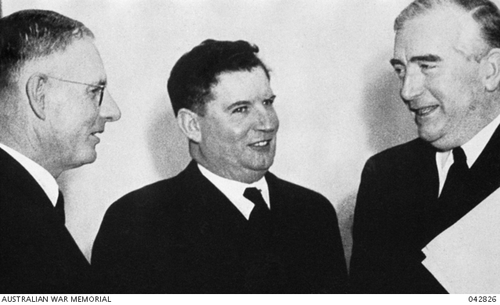
Sub-strand: Second World War
Content description:
The significance of the Second World War to Australia’s immediate post-war economic, political and social development, and Australia’s international relationships in the 20th century (AC9HH10K05)
How the presentation relates to the content description:
The speech challenges the traditional view that Australia’s engagement with Asia began after WWII by identifying early diplomatic efforts starting in 1939, when Prime Minister Robert Menzies declared Australia must maintain its own diplomatic contacts in the Pacific.
It highlights Australia’s first independent diplomatic missions to Japan and China in 1940–41, established before any such presence in Washington, showing that diplomatic relationships with Asia were prioritised during the war itself.
Introduces figures like Charles Lee, Australia's first Chinese-Australian diplomat, who served during the war in China, indicating early multicultural involvement despite the White Australia Policy.
Shows how WWII, particularly the threat of Japan, was the catalyst for Australia’s shift away from reliance on Britain and towards regional self-determination and diplomacy in Asia.
Three of Australia’s five World War II prime ministers: Curtin, Fadden and Menzies.
Source: Australian War Memorial

Slide 4
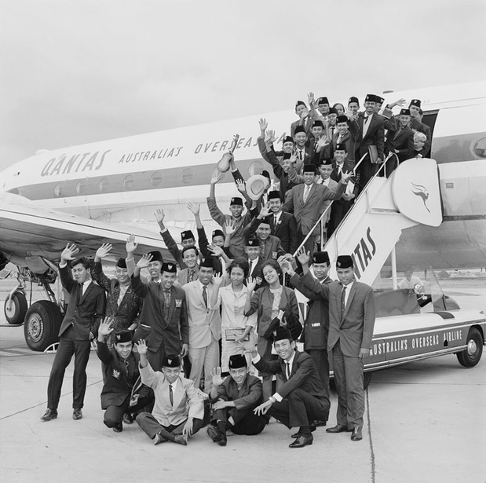
Sub-strand: Building modern Australia (post-1945)
Content descriptions:
The effects of significant post Second World War world events, ideas and developments on Australian society (AC9HH10K07)
The causes of changes in perspectives, responses, beliefs and values on migration that have influenced Australian society since 1945 (AC9HH10K08)
How the presentation relates to the content descriptions:
Traces how Cold War geopolitics shaped Australia's alliances, including support for South Vietnam, participation in SEATO, and defence of Malaysia during Konfrontasi.
Describes Australia's development of foreign aid as a tool of diplomacy and anti-communist strategy, particularly through the Colombo Plan, which promoted economic development and educational exchange.
Explores post-war reconciliation and economic engagement with Japan, including the 1957 Commerce Agreement and support for Japan’s integration into international institutions.
Shows how Australia's economic and strategic position evolved as Britain withdrew from the region and joined the European Economic Community, leading to a more independent and Asia-focused policy direction.
Indonesian Colombo Plan students on the steps of a Qantas aircraft
Source: National Archives Of Australia

Slide 5
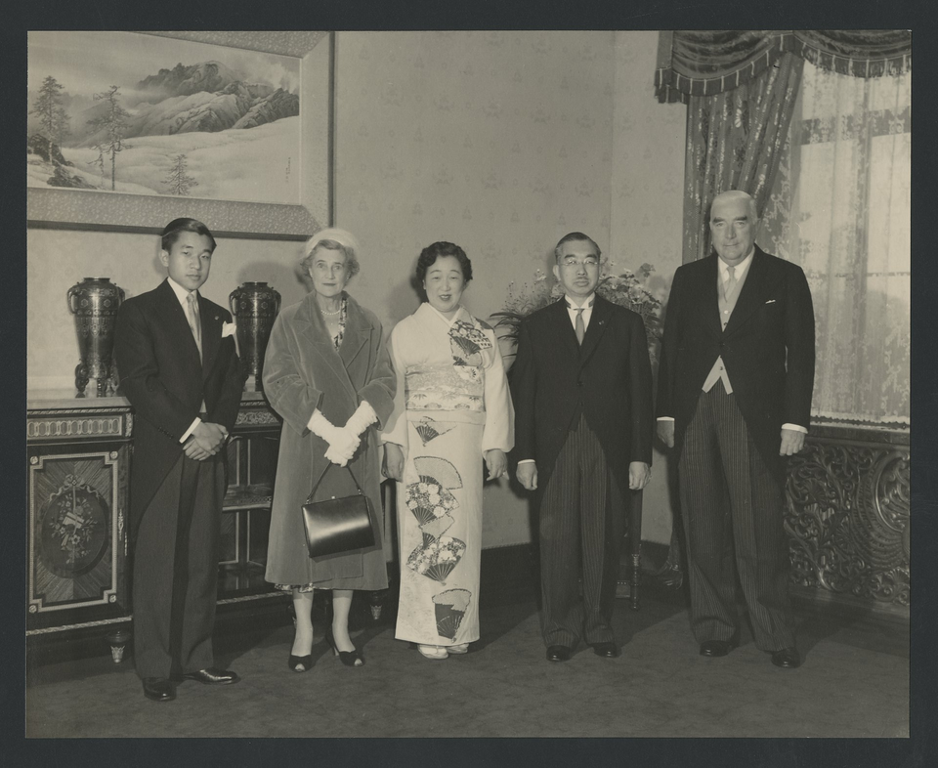
Sub-strand: The globalising world
Content descriptions:
Causes and effects of the significant events and developments of the major global influences on Australia in the post–the Second World War period (AC9HH10K16)
The effects of global influences on Australia’s changing identity as a nation and its international relationships (AC9HH10K19)
How the presentation relates to the content descriptions:
Explains how WWII, decolonisation, and the Cold War reshaped Australia’s engagement with Asia, forcing a shift from reliance on Britain to independent diplomacy and alliances in the region.
Highlights how Australia built new relationships with Malaya, Japan, Indonesia, and China, reflecting broader global shifts in power and Australia’s need to position itself within Asia.
The end of the White Australia Policy, the Colombo Plan, and growing regional trade links challenged old prejudices and gradually redefined Australia’s identity as a multicultural, Asia-engaged nation.
Shows how global developments—such as US strategic dominance, the spread of communism, and Britain’s retreat from Asia—directly shaped both Australia’s foreign policy decisions and its self-understanding as a nation.
Crown Prince Akihito, Pattie Menzies, Empress Kōjun, Emperor Hirohito and Robert Menzies during Menzies' visit to Japan in 1957
Source: Baillieu Library, University of Melbourne

Slide 6
Section 2
How does the presentation relate to the cross-curriculum priorities and general capabilities in the Australian Curriculum?

Slide 7
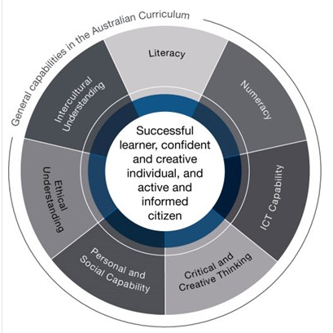
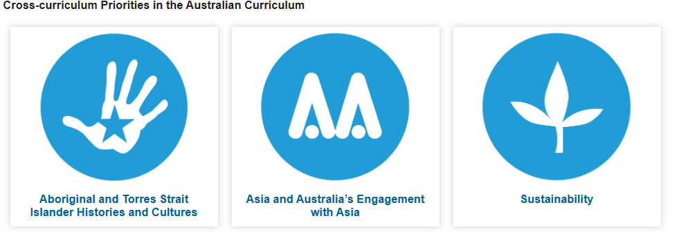

Slide 8
Section 3
How is the presentation's content transferable to the Year 10 History classroom?

Slide 9
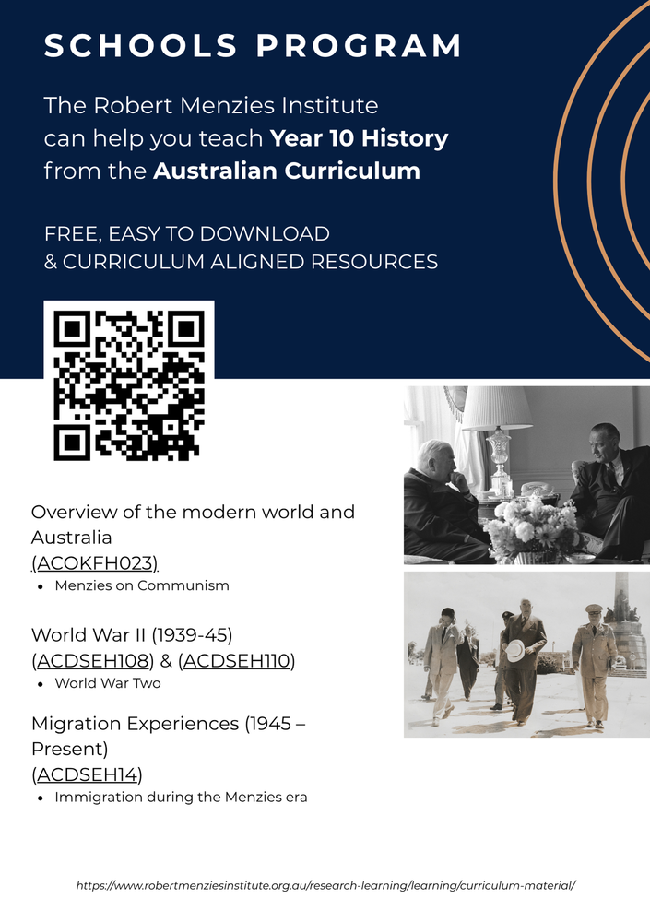
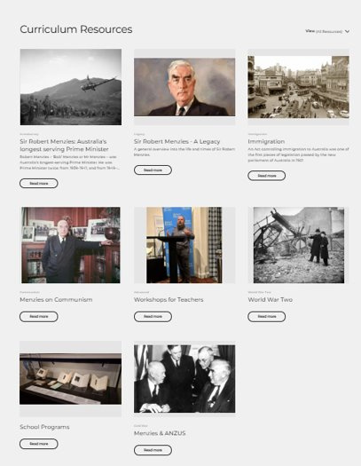
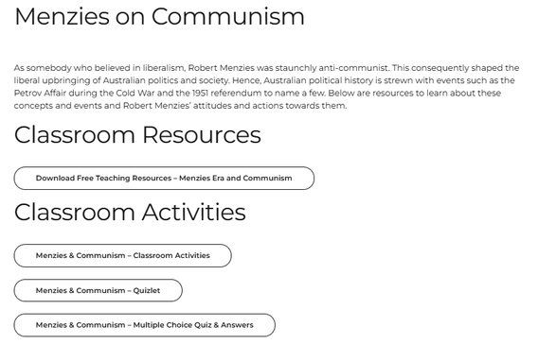
Curriculum Resources
​
https://www.robertmenziesinstitute.org.au/research-learning/learning/curriculum-material/
Option 1: survival mode
Year 10 History in p6 on Friday?
“Survival is success”
​Classroom resources and pre-made activities:
Free​
Downloadable
Classroom ready
​Curriculum aligned​
Knowledge rich
Skill focused

Slide 10
Identify two ways First Nations Australians engaged with Asia before European settlement.
Describe how the idea of the “tyranny of distance” influenced early settler attitudes towards Asia.
Explain why NSW Premier Sir Joseph Carruthers supported Japan during the Russo-Japanese War.
Outline the significance of Australia establishing its first independent diplomatic missions in 1940–41
Analyse the impact of the White Australia Policy on Australia’s engagement with Asia during the mid-20th century.
Explain how the Colombo Plan contributed to Australia’s regional relationships.
Evaluate the reasons why the 1951 Peace Treaty with Japan was controversial, and its long-term significance.
Discuss Australia’s role in Indonesia’s independence and the challenges that followed.
Assess how Cold War tensions shaped Australia’s diplomatic and military involvement in Asia.
Analyse how Britain’s withdrawal from Asia and the US rapprochement with China in the late 1960s–early 1970s influenced Australia’s identity and foreign policy.
Option 2: Professor McGonagall from Harry Potter
High standards & traditional pedagogy “Sage on the stage”
Suitable for Senior Australian History
Learning Intention: To explore how Australia’s identity and engagement with Asia evolved between 1941 and 1972 through an historian’s interpretation
Learning Materials: Zac’s slideshow and speech
1. Using Zac’s slides and presentation notes, replicate Zac’s presentation (or part of it) to your class
2. Students can take notes, and you may wish to give them excerpts of Zac’s speech to read independently
3. Students then answer 10 questions in their workbooks
EVEN BETTER – you may wish to ask for a free digital incursion where Zac could deliver the content to your class!
Notes:
10

Slide 11
UN in Schools:
​
https://unaavictoria.org.au/wp-content/themes/unaav/docs/munc_program_brochure.pdf
Option 3: Mr Keating from Dead Poet’s Society
Creative & fun “Guide on the side”
Suitable for Middle Years History
Lesson 1:
Research your given historical figure
Basic facts (birth / death / political achievements / key events)
How did they contribute to Australia or their country?
How would your character have understood Australia and its role in the world?
What involvement did your person have with Australia’s engagement with Asia?
2. Prepare a 1-minute statement to introduce your person and to describe his/her stance on Australia’s identity and engagement with Asia.
Lesson 2:
3. Each student presents their statement. Through listening to others, form alliances with other like-minded people. (active listening & ally/neutral/enemy)
4. Each character answers the following 3 questions in workbooks
Identify how Australia’s identity and role in Asia change from 1941-1972
Explain your character’s role this evolution.
Evaluate what your character would have thought of this evolution.
Learning Intentions:
To explore how Australia’s identity and engagement with Asia evolved between 1941 and 1972 through the perspectives of key historical figures
To develop historical empathy and critical thinking by researching, role-playing, and articulating the viewpoints of diverse historical figures
Learning Materials: Zac’s slideshow
Classroom Set Up: Horseshoe (like the UN)
Scenario: It’s a mock international summit on Australia’s engagement with Asia. 20 historical figures have been invited to represent diverse views on Australia’s identity and engagement with Asia from 1941-1972.

Slide 12
H.V. Evatt – Australian Foreign Minister during WWII; pushed for Australia’s independent voice in diplomacy.
Robert Menzies – Prime Minister; conservative, pro-British, led Australia through early Cold War.
Percy Spender – Minister for External Affairs; architect of the Colombo Plan and ANZUS Treaty.
Ben Chifley – PM after WWII; dealt with reconstruction and Australia’s early engagement with Asia.
Gough Whitlam – Opposition Leader (later PM); recognised China
Harold Holt – Australian PM; famous for “All the way with LBJ.”
Al Grassby – Immigration Minister under Whitlam; championed multiculturalism and dismantled White Australia.
Zhou Enlai – Chinese Premier; key figure in China’s diplomacy with the West.
Soekarno – Indonesia’s first President; led independence struggle, tested relations with Australia.
Tunku Abdul Rahman – First Prime Minister of Malaysia; ally in regional cooperation.
John Curtin – PM during WWII; turned to the US after the fall of Singapore.
Sirimavo Bandaranaike – Prime Minister of Ceylon (Sri Lanka); first female head of government in the world (1960)
Indira Gandhi – Key political figure in India; became a central leader in the Indian Congress Party (later PM in 1966).
Richard Nixon – US President; opened relations with China, influencing Australia’s strategic outlook.
Lyndon B. Johnson – US President; pushed Australia to support the Vietnam War.
Seán MacBride – Irish statesman at the UN; often worked with Evatt on decolonisation debates.
Dame Enid Lyons – First woman elected to the Australian House of Representatives (1943); advocated for women’s political participation.
Dame Zara Holt – Wife of Harold Holt; promoted Australian culture and international goodwill.
Margaret Whitlam – Activist and public figure; championed social welfare, women’s rights, and international engagement.
Arthur Calwell – Opposition Leader; defended White Australia Policy well into the 1960s.
20 historical figures at the summit

Slide 13
Section 4
How can the Robert Menzies Institute support you in the history classroom?

Slide 14
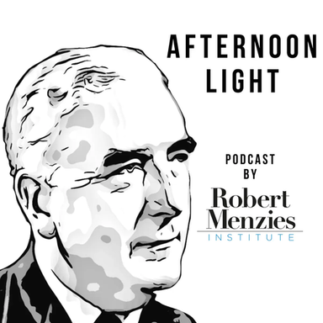
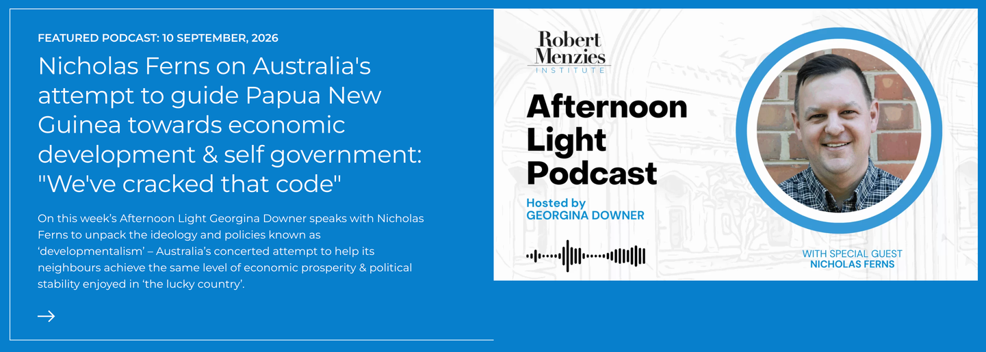
a) Nourish your history teacher’s soul
Recent Afternoon Light Podcasts that relate to Australia’s engagement with Asia
Nicholas Ferns on Australia’s attempt to guide Papua New Guinea towards economic development and self government
Sir Peter Cosgrove on Vietnam, his experience in the ADF & Australia's current defence concerns: "underscore and capitalise DETERRANT"
https://www.robertmenziesinstitute.org.au/research-learning/research/afternoon-light-podcast/

Slide 15
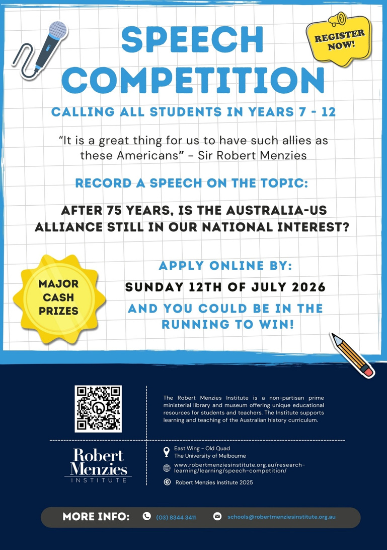
b) Purposeful extension for your students
Key Information:
Prepare, practice, record and upload a speech addressing the 2026 theme.
You must refer to Robert Menzies’s role in the alliance as well as the broader historical context in which it was formed.
Time allocations:
Year 7/8 Category: 3-5 minutes
Year 9/10 Category: 4-6 minutes
Year 11/12 Category: 5-7 minutes
Prizes:
Year 7/8 Category: $500 + $200 worth of books
Year 9/10 Category: $1,000+ $200 worth of books
Year 11/12 Category: $1,500 + $200 worth of books
https://www.robertmenziesinstitute.org.au/research-learning/learning/speech-competition/
Notes:
15

Slide 16
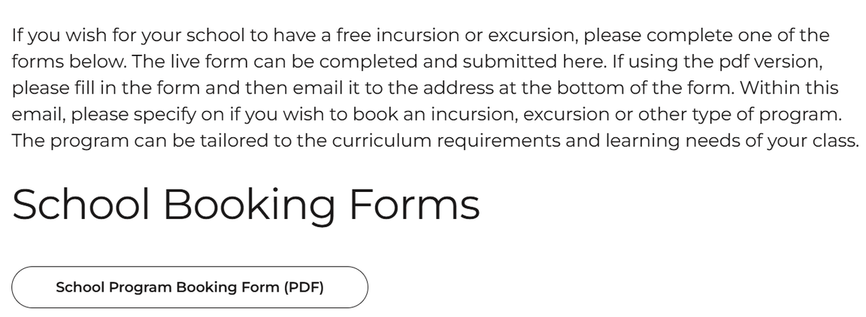
c) Free incursions / excursions
https://www.robertmenziesinstitute.org.au/curriculum-resource/school-programs/
In particular: incursions / excursions on the Cold War!
Feel free to send an email enquiry to schools@robertmenziesinstitute.org.au
OR
Get in contact via the form on the website

Slide 17

d) Free or cheap teacher membership!
Free teacher membership of the Robert Menzies Institute if you're a member of a state history teachers’ association!
(a saving of $25)
https://www.robertmenziesinstitute.org.au/about/membership/

