Slide 1
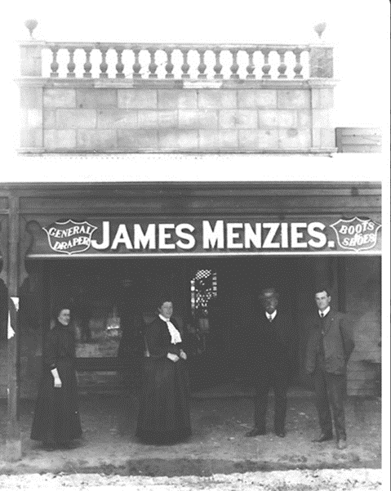
Early Life
Robert Menzies was born in the small town of Jeparit, Victoria on 20 December 1894. His father, James, who owned the Jeparit general store, was of Scottish background and the family of his mother, Kate, was originally from Cornwall, England.
Menzies grew up with parents who were both devout Christians and devoted to the ideals of public service. His father served on the Dimboola Shire Council (and was twice elected Shire president) and was a member for the district of Lowan in the Victorian Legislative Assembly from 1911 to 1920.

Slide 2
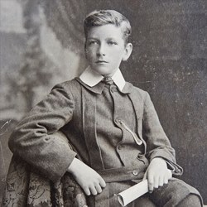
Schooling
Menzies began his schooling in 1899 at the age of four and a half at Jeparit primary school. Altogether, there were thirty students attending the one-room school.
In 1907, aged 13, Menzies was ranked first in the State-wide scholarship exam. This was a huge achievement as the scholarship paid for his secondary education – the equivalent of Years 9 to 10 - at any Victorian private school. Against his father’s advice, Menzies chose to go to Wesley College, where his mates were going.
He went on to graduate from a law degree at the University of Melbourne in 1916.

Slide 3
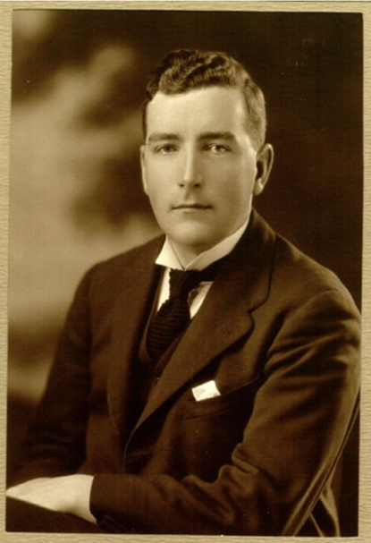
Early Career
Menzies built up a successful law practice, focusing on Constitutional law. He was admitted to the Bar in 1918, thus becoming a barrister and in 1929 he was made a King’s Counsel, the youngest in Victoria.
Following in his father’s footsteps, Menzies entered politics at the State level in 1928, first as a member of the Legislative Council and then as a member of the Legislative Assembly.
Subsequently, in 1934, he was successfully tempted to enter federal politics by Prime Minister Joseph Lyons, who promised him the position of Attorney General if the United Australia Party won the election.

Slide 4
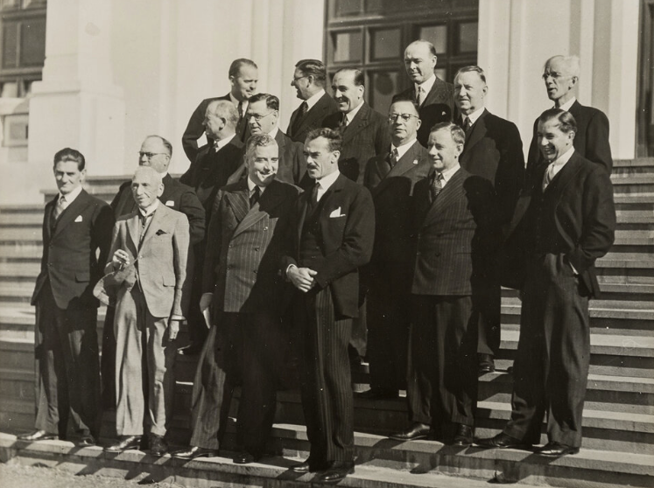
As Federal Attorney-General, Menzies became embroiled in some contentious issues which plagued the Lyons Government. One particular issue earned him the nickname ‘pig-iron Bob’.
In 1939, Menzies resigned from Cabinet in protest at the Lyons’ government’s failure to uphold its election promise of establishing a proper National Insurance scheme which would support Australians who were ill, unemployed, poor or in their old age. Despite this, when Lyons died in 1949, Menzies was elected leader of the United Australia Party and thus Prime Minister of Australia. He served in this role for a period of just over two years, until the election of John Curtin’s Labor government in 1941.
Political Career

Slide 5
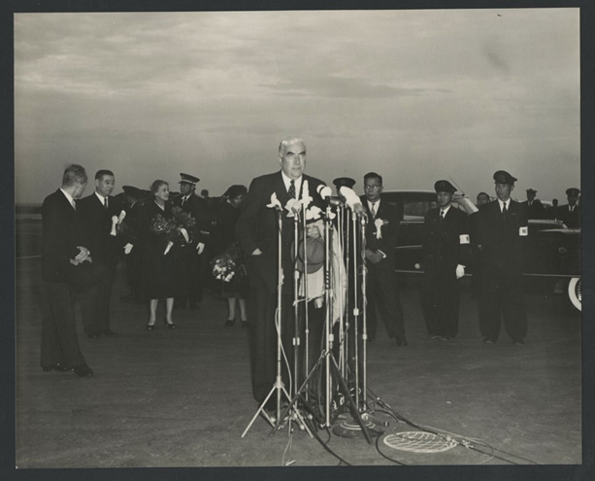
In 1944, Menzies spearheaded the formation of the Liberal Party, which included the United Australian Party plus seventeen other non-Labor parties. Menzies’ vision for the party was ‘a true revival of liberal thought which will work for social justice and security, for national power and national progress, and for the full development of the individual citizen…’
Menzies’ second term, which began in 1949 and ended in 1966, was regarded as a period of economic growth, increased prosperity for Australians and great social change for Australia. Among the many achievements of Menzies’ government was a rapid rise in home ownership and the establishment of Commonwealth scholarship schemes for education. Menzies was active on the international stage, playing a key role in the creation of ANZUS and SEATO.
Legacy

Slide 6
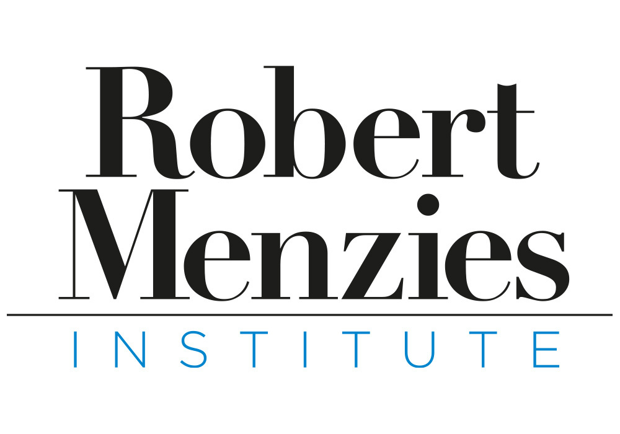
To view more educational resources, please visit:
https://www.robertmenziesinstitute.org.au/research-learning/learning/classroom-resources/

