Slide 1
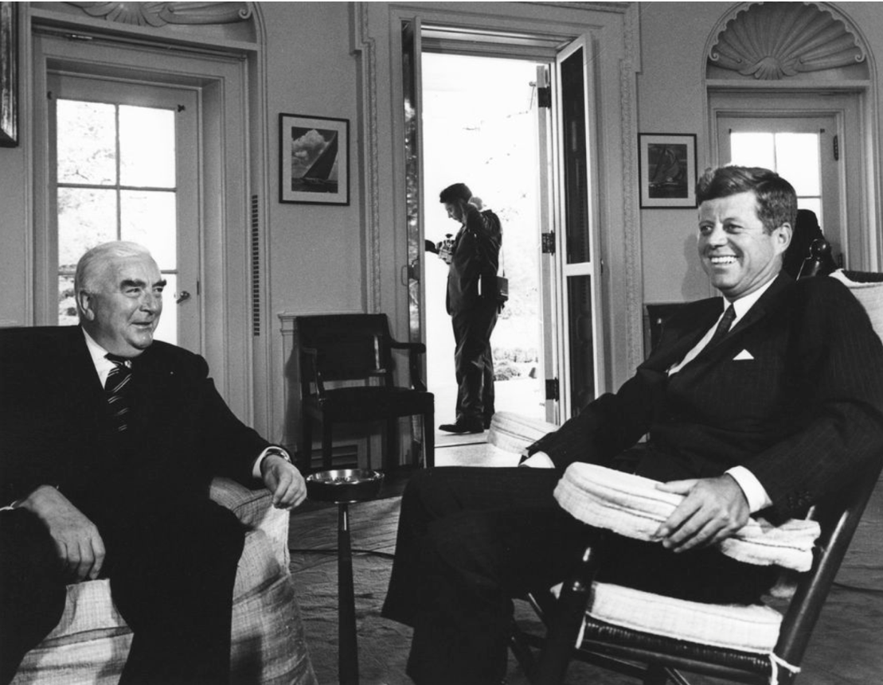
The Defence of Australia
From 1788, the British Empire assumed responsibility for defending the Australian continent against external forces. In February 1942, after progressive weakening, this arrangement failed. Not only were 15 000 Australian soldiers taken prisoner by the Japanese for the duration of World War Two, but the Japanese bombed Darwin in the Northern Territory. It was now very clear that Australia needed to forge other alliances both during wartime and for a post-World War Two world.

Slide 2
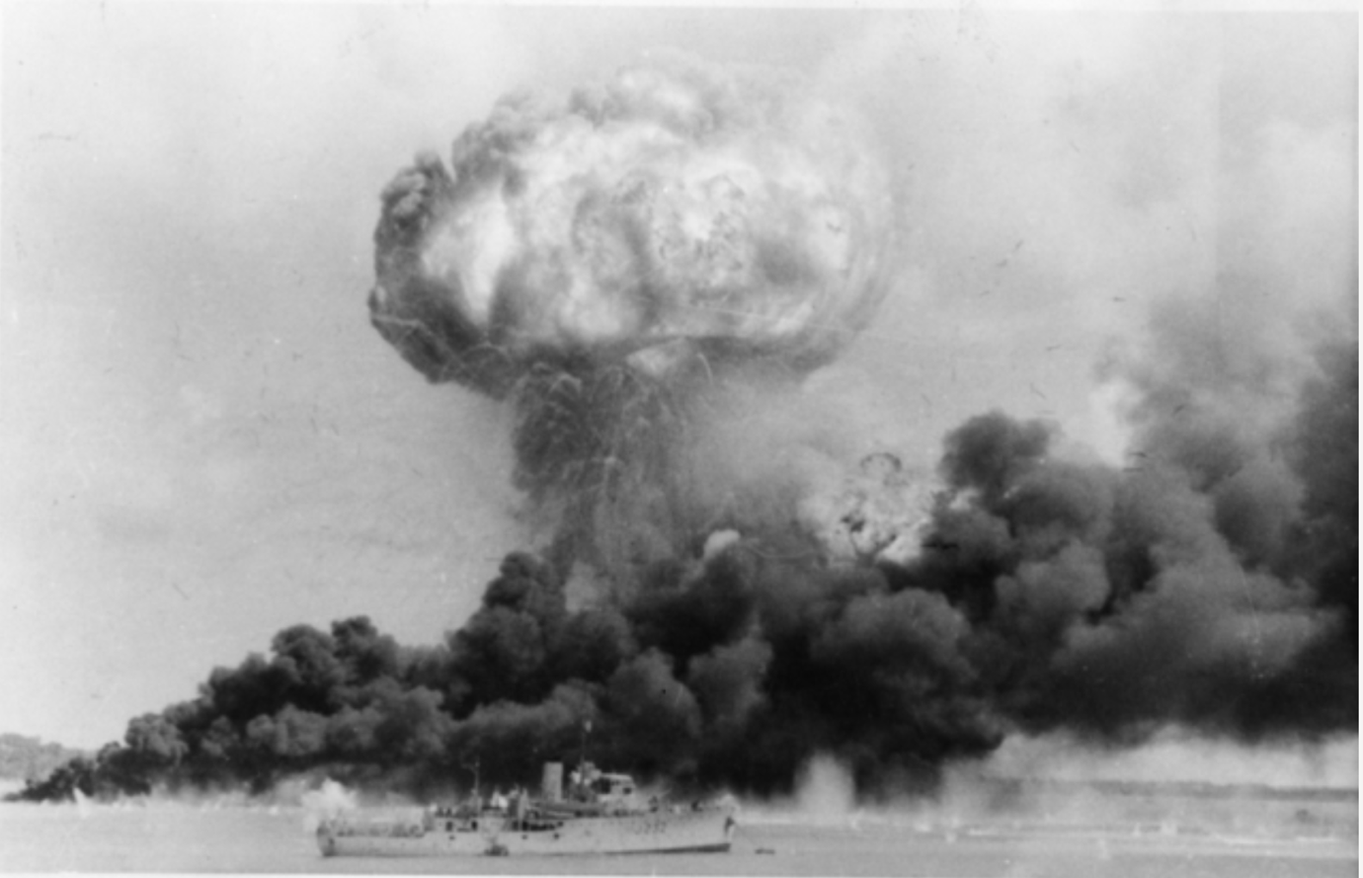
Despite having fought together against Nazi Germany during World War II, the Soviet Union and its western allies soon parted ways once the war was won. Great Britain and the United States feared that communism would spread across Europe and threaten democracy. So effectively, by the end of 1948, a new kind of war had begun: the Cold War.
Australia, through its ties to both Great Britain and the United States and its geographical proximity to South-east Asia, became involved in the Cold War and ultimately was drawn into sending troops into proxy wars such as the Korean and Vietnam Wars. The Cold War period finally ended with the dissolution of the Soviet Union into its original sovereign countries at the end of 1991.
The Cold War: a New Kind of War

Slide 3
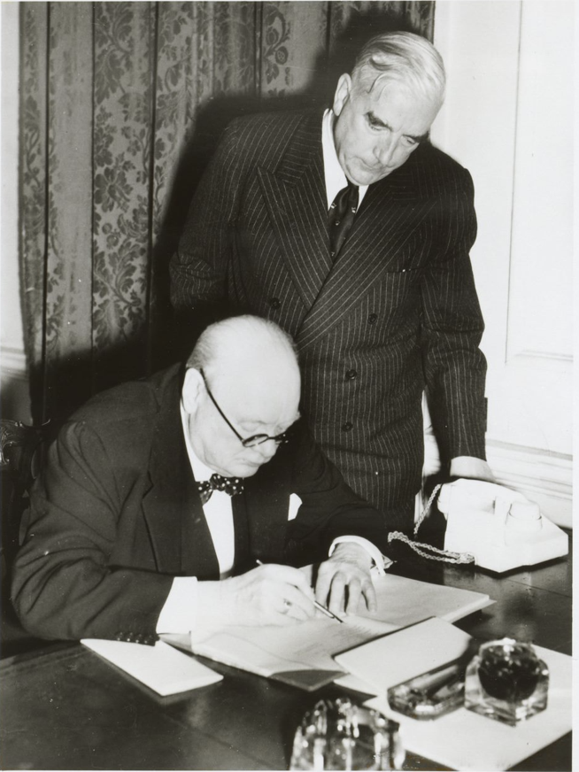
Menzies and a New Alliance
In the post-war period, as the political world realigned itself, the larger Allied powers were focused on rebuilding Europe and Japan. It became clear to Menzies and his cabinet that it was important for Australia to position itself as a power in the South-east Asian and Pacific regions and on the world stage to protect its interests.
These concerns were shared by Australia and New Zealand, leading to the creation of a pact to work together to achieve shared goals in the international arena. This agreement, most commonly called the ANZAC Pact, was signed on 21 January 1944.
Next, Menzies made the decision to ally with the U.S. to solidify Australia’s role as a political power in the Pacific region. The outcome of this decision was the ANZUS treaty, signed on 1 September 1951.

Slide 4
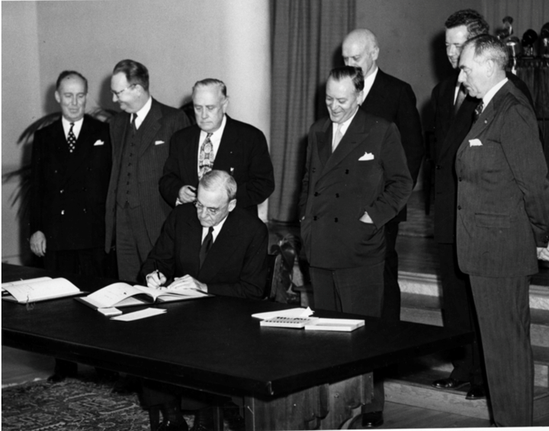
The ANZUS Treaty
Menzies considered the ANZUS Treaty, between Australia, New Zealand and the United States, to be his greatest legacy. The treaty gave the small countries of Australia and New Zealand a ‘great and powerful friend.’
The treaty gave Australia the security of knowing that if a foreign power attacked Australia, we had allies within the region who would come to our aid. It has proven to be a successful alliance as it is still going strong over seventy years later, despite the withdrawal of New Zealand in the 1980s due to its concerns over US nuclear-powered submarines.

Slide 5

To view more educational resources, please visit:
https://www.robertmenziesinstitute.org.au/research-learning/learning/classroom-resources/

