Slide 1


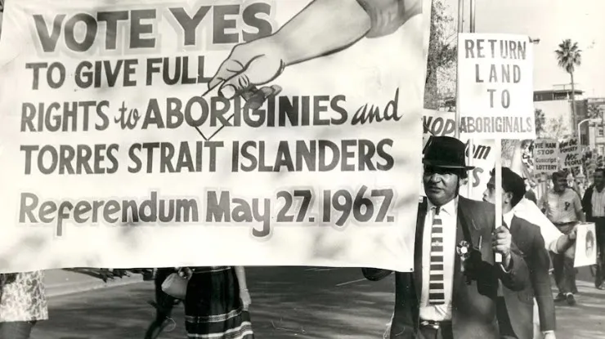

Colourblind or Intentionally Blind? Federal Indigenous Policy 1901-1967
Dr Zachary Gorman, Historian of the Robert Menzies Institute
At the University of Melbourne
Source: Noel Butlin Archives Centre, Australian National University
Notes:
1

Slide 2
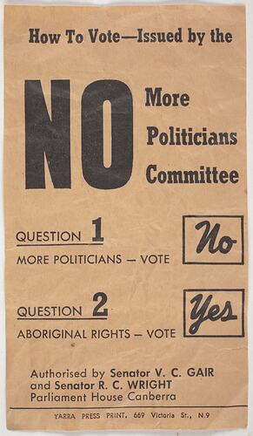
Mythologies of 1967
  ‘Forgotten’ referendum on the Nexus Clause, arguably considered a greater priority for the government at the time
  Widespread belief that the referendum granted citizenship & voting rights
  Complex story, but need to understand its complexities in order to avoid misrepresentation
Source: Museums Victoria
Notes:
2

Slide 3
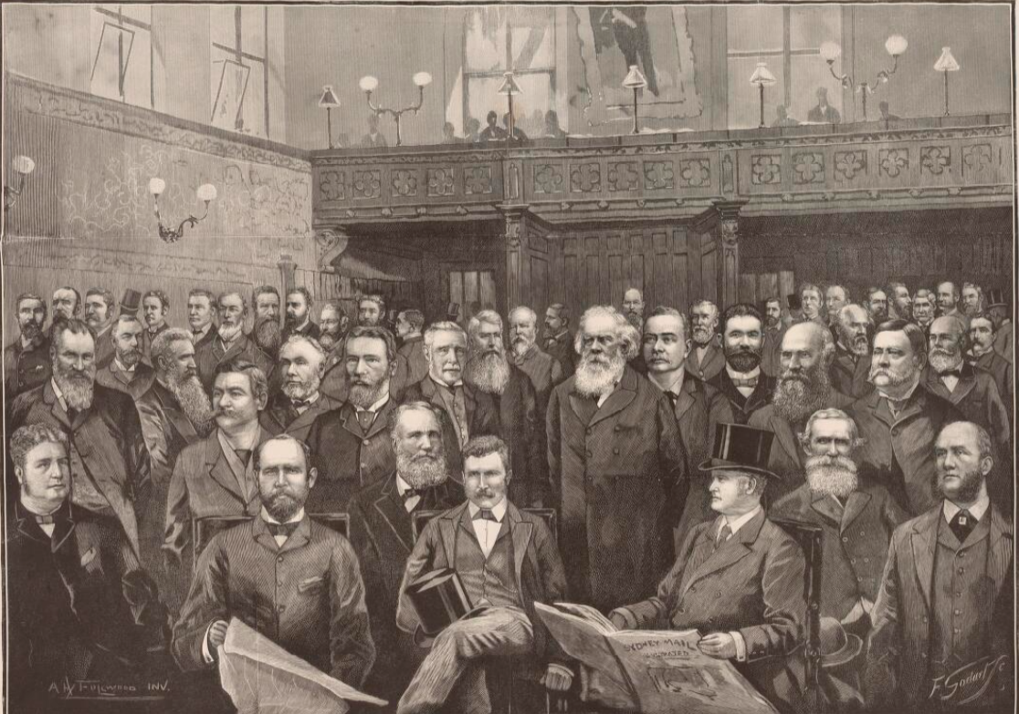
Section 127
  Census used for constitutional mechanisms, most importantly allocating House of Reps seats
  Different voting rights in different States: WA & QLD the worst, SA the best
  Section 41 theoretically protect the votes of those who already had the right
  John Cockburn recognise impact of exclusion & object to it
Source: National Library of Australia
Notes:
3

Slide 4
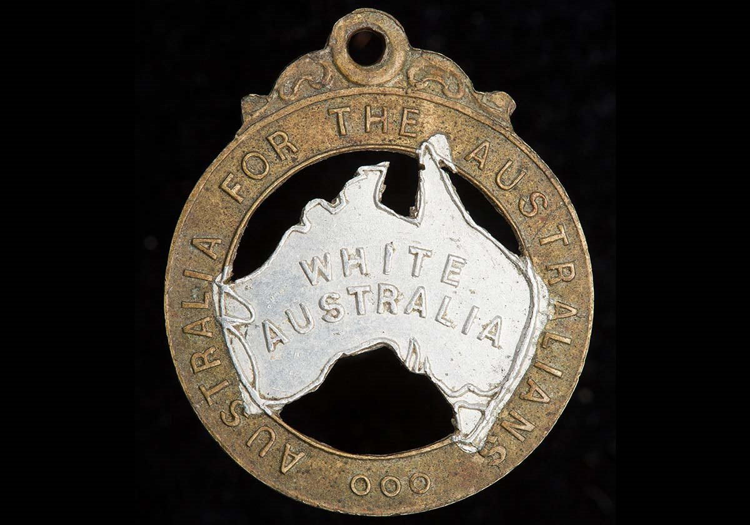
Section 51 (xxvi)
  Overlap between Sections 127 & 25 show immigrants could also be excluded from the census
  Race Power aimed at discriminating against non-British immigrants & their descendants
  Māori demonstrate that the various First Nations were quite distinctive
  Federal Government could still pass legislation impacting Indigenous people, just restricted from passing legislation exclusive to them
Source: National Museum of Australia
Notes:
4

Slide 5
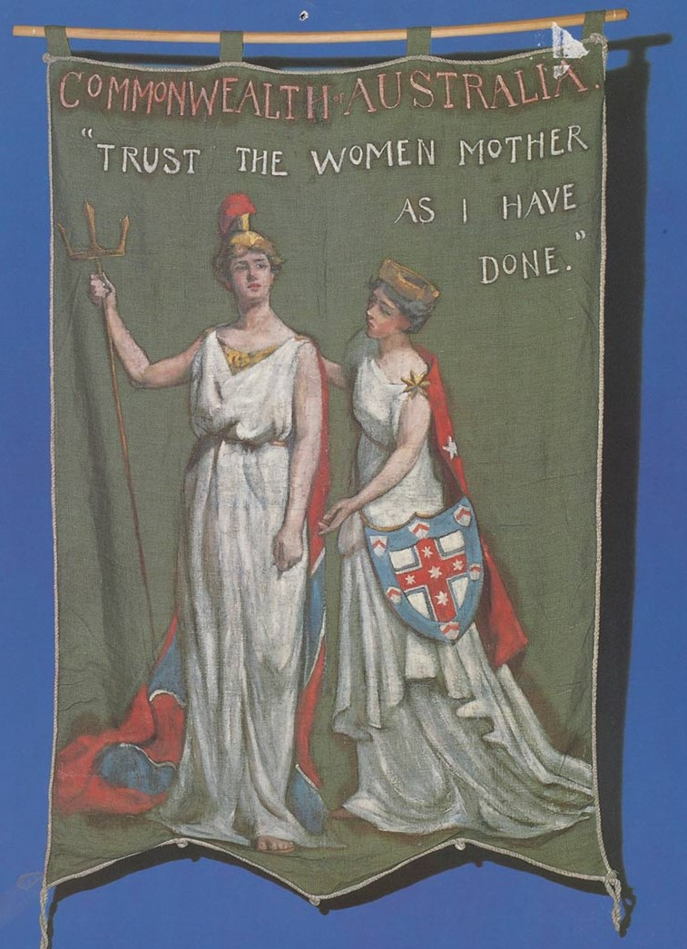
Legislative Exclusion
  Commonwealth Franchise Act 1902 give women the vote
  Amendment disenfranchising Indigenous people not initially included, Richard O’Connor dub it ‘monstrous’
  Exclusion of ‘Aboriginal Natives’ find its way into social services legislation & cover people of Asian or Pacific descent
  British diplomatic pressure improve situation for immigrants but not for First Nations
Source: National Museum of Australia
Notes:
5

Slide 6
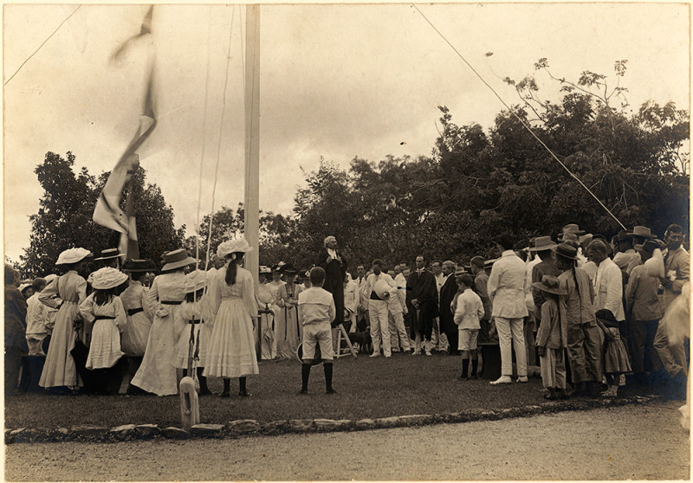
Northern Territory
  Commonwealth takeover 1 January 1911
  Federal Control ‘every bit as oppressive as it was in Queensland and Western Australia’
  Aboriginals Ordinance 1918 restrict movement, employment, marriage, alcohol & more
  Commonwealth not even spend more money than the States
  1930s a decade of regression rather than progress
Source: National Library of Australia
Notes:
6

Slide 7
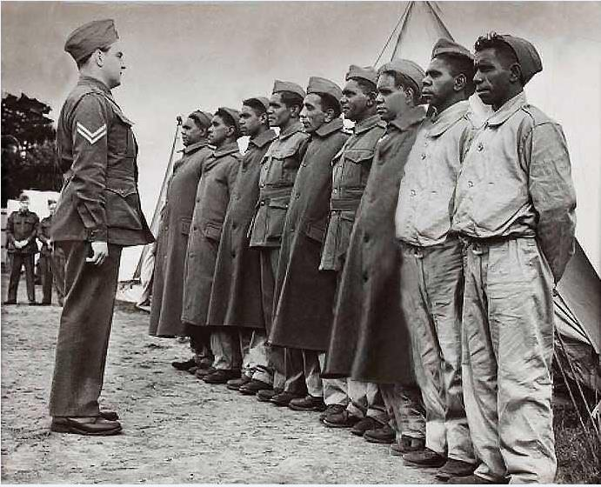
1940s: War as a catalyst for limited recognition
  1940 see soldiers given voting rights but only for duration of the war
  William Cooper an early advocate of Commonwealth takeover
  1944 ‘14 Powers’ Referendum fail
  Nationality & Citizenship Act 1948 grant citizenship without rights
  Commonwealth Electoral Act 1949 give practical effect to what had been promised in Section 41
Source: Argus Newspaper Collection of Photographs, State Library of Victoria

Slide 8
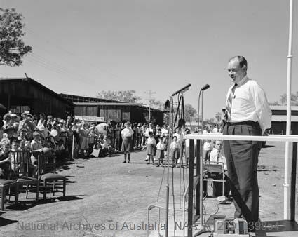
1950s: ‘Equality’ through Assimilation
  Silence on impact of British nuclear tests
  Admittance to social security, but only if choosing a ‘settled’ life
  Paul Hasluck, Minister for Territories 1951-63 study Indigenous policy but hardly ‘enlightened’
  1953 Welfare Ordinance remove racial categories in administration of Northern Territory, but leave most Indigenous People facing the same restrictions they had before
  1962 Electoral Act open decade in which reform was increasingly demanded
Source: National Archives of Australia
Notes:
8

Slide 9
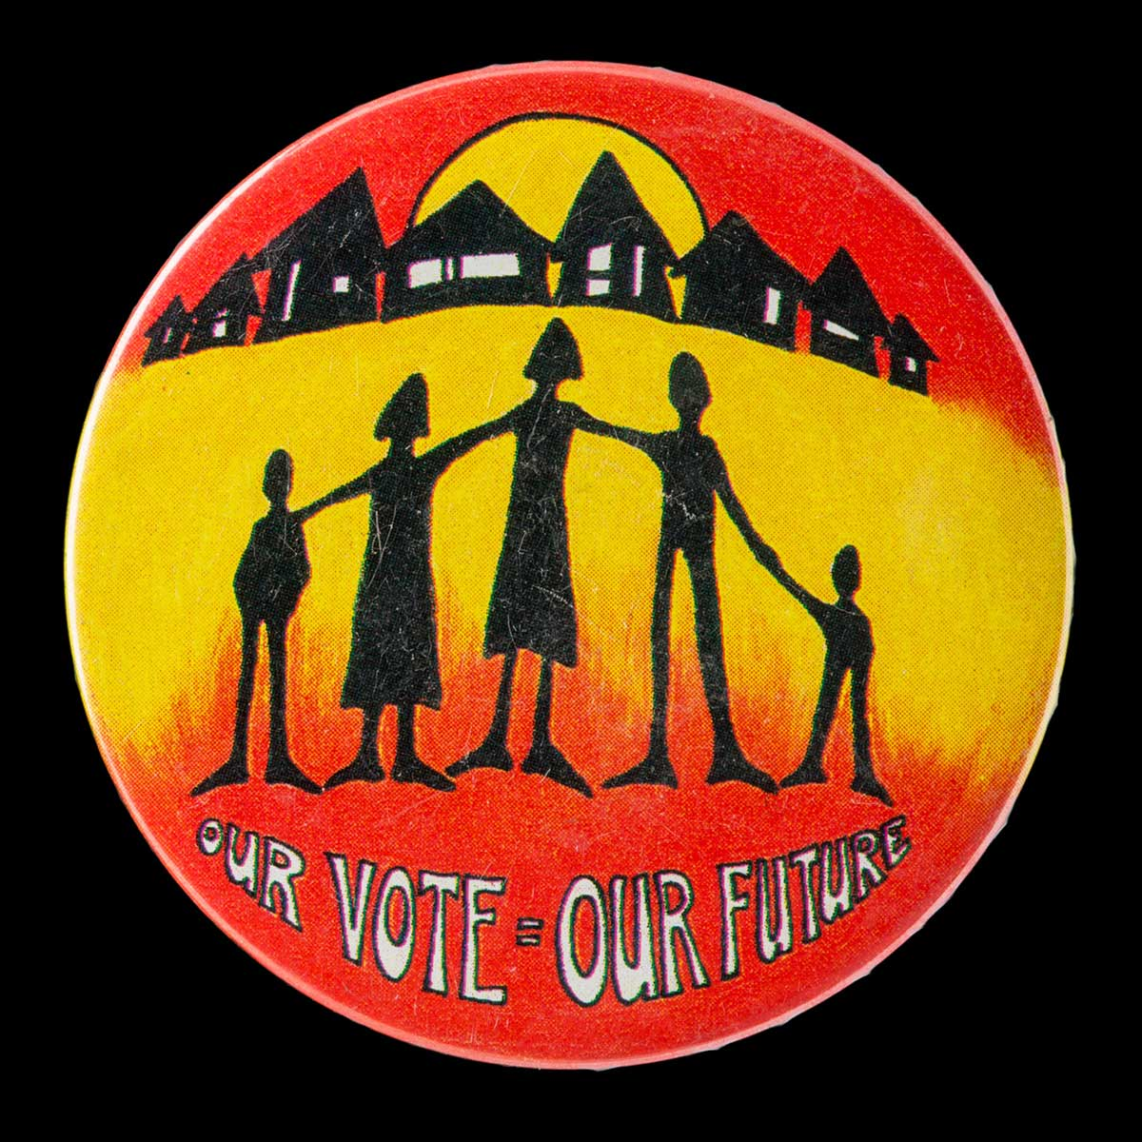
1967 Referendum
  Assumption Australian Constitution enshrined ‘rights’ like USA
  Importance of international criticism, particularly amidst the Cold War
  Extension of 51 (xxvi) open the way for ‘positive’ discrimination
  Debate about equal rights vs equal outcomes conveniently downplayed
  Commonwealth direction start 1972, based largely on Section 96
Source: National Museum of Australia

