Slide 1


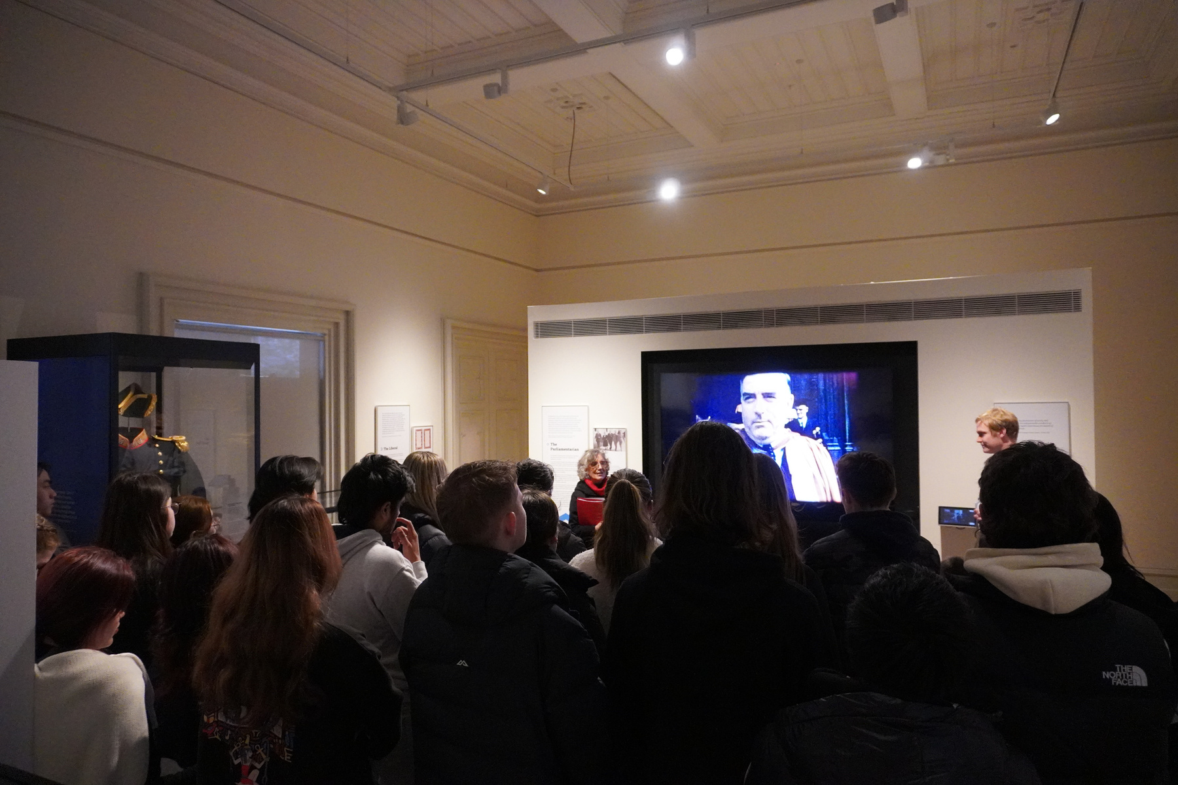

To Discriminate or to Populate? Dismantling White Australia
Dr Zachary Gorman, Historian of the Robert Menzies Institute
At the University of Melbourne
Notes:
1

Slide 2
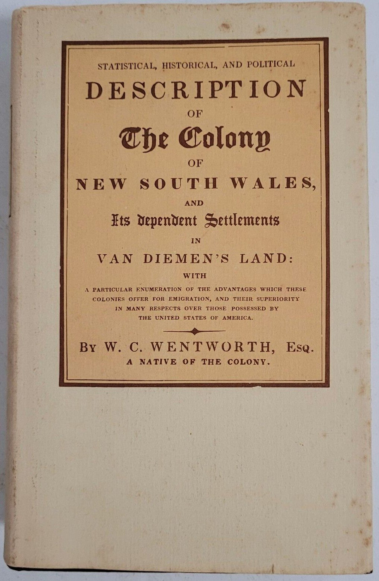
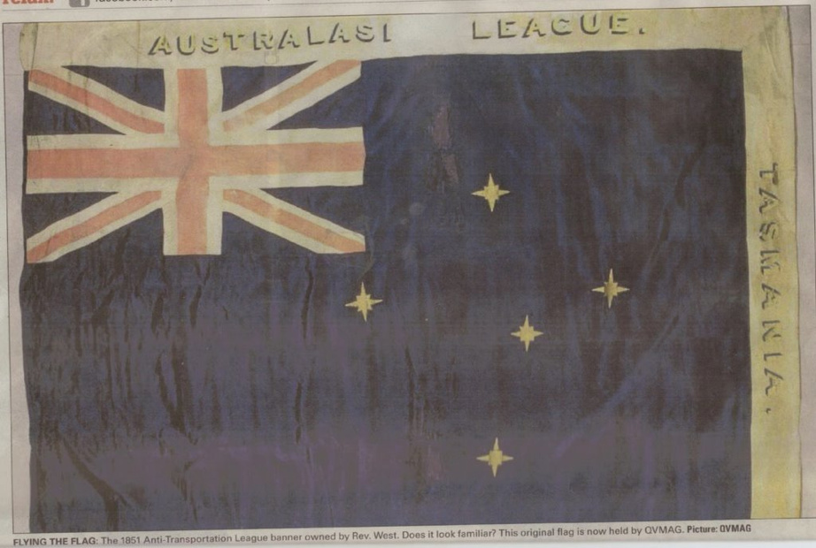
19th Century Roots
First book ever published by an Australian born author sell migrant destination
Defensive of the high wages enjoyed in the 'working man's paradise'
Campaign against Convict Transportation encapsulate anti-immigrant themes: undercutting jobs & wages, social cohesion, functioning of democracy
Racial outbursts on the goldfields
Pluralist approach to religious diversity
Notes:
2

Slide 3
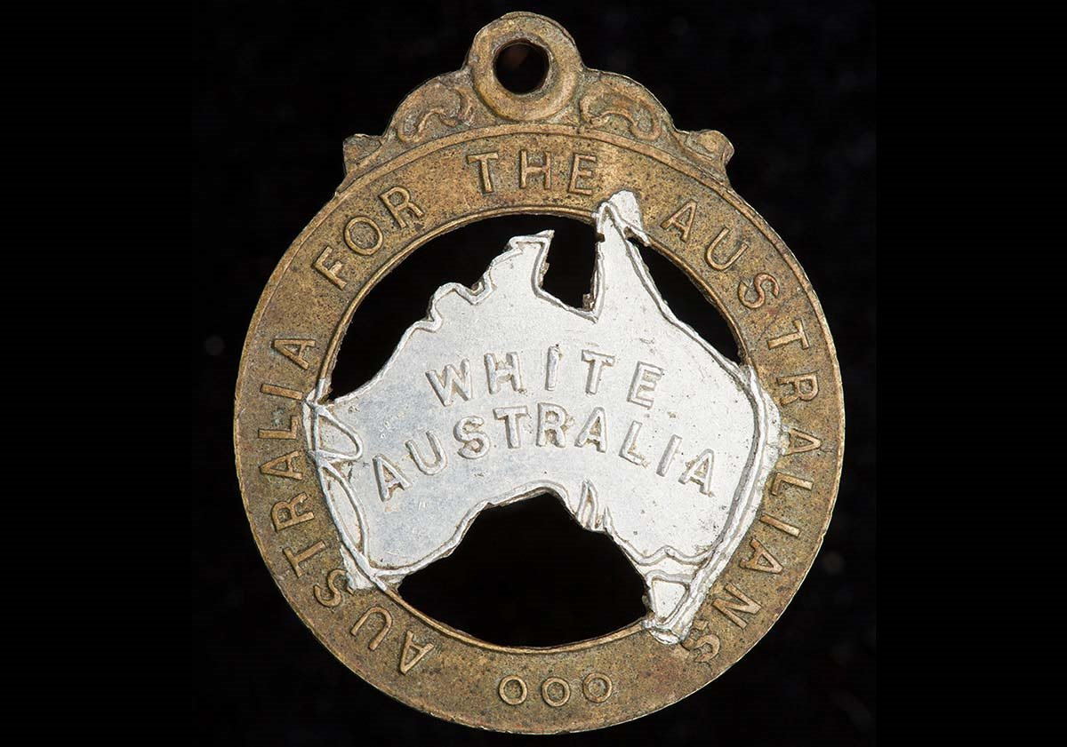
Origins of White Australia
Justifications: Tyranny of distance, prevent ethnic conflict, protect the working man
Federation campaign simultaneous with 1890s depression, heighten sense of economic insecurity
Deportation of Pacific Island Labourers
Irony that dictation test implemented to avoid embarrassing the British
Australian Natives' Association give special place to those who were born here
Insular society seen not only in immigration policy but also adoption of Protectionist Tariffs

Slide 4
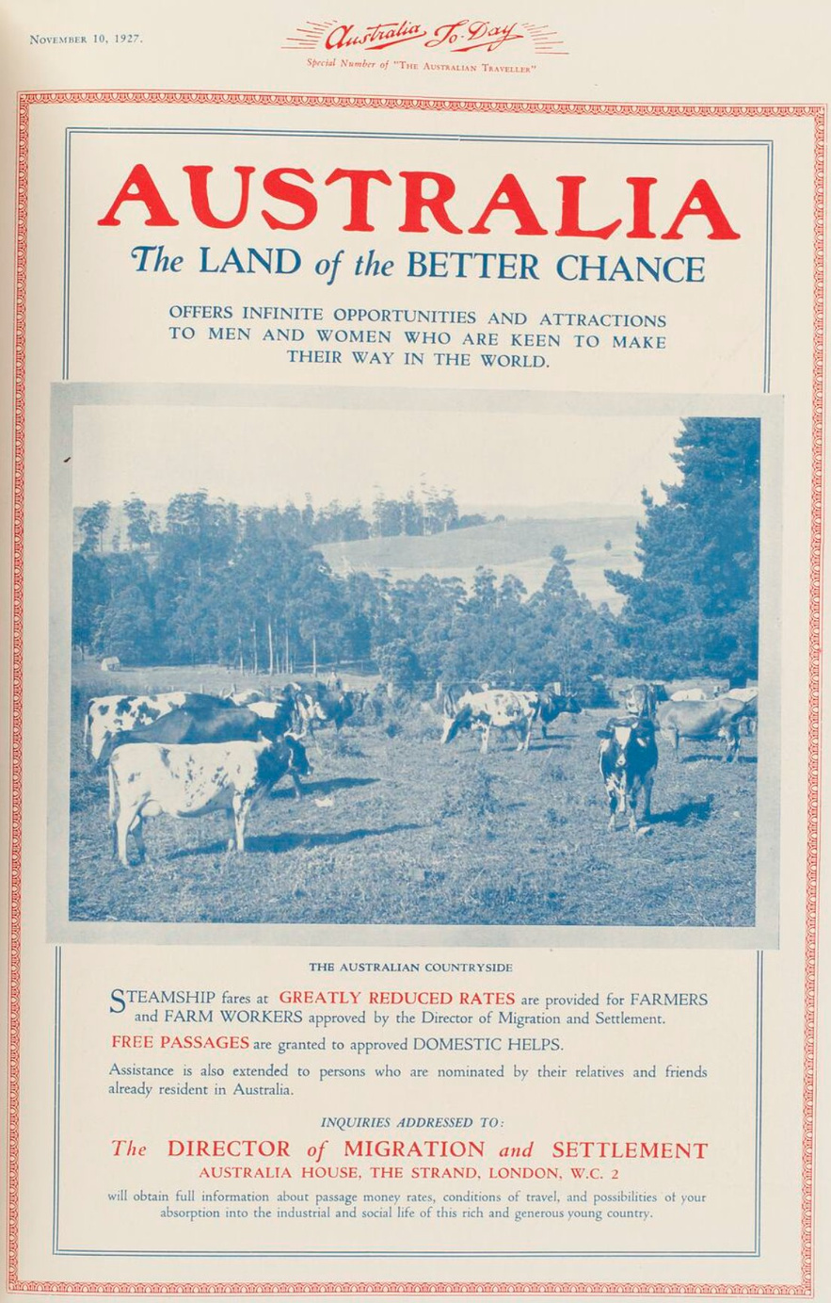
Imperative to Populate
Federation's goals on defence and migration were contradictory
Russo-Japanese war of 1904-5 prove that Asian nations could beat Western nations, lead to first explicit calls that 'we must have population or perish as a race'
By 1913 Opposition Leader Joseph Cook coin the exact phrase 'populate or perish'
1920s = Bruce's 'Men, Money, Markets', 340,000 new migrants

Slide 5
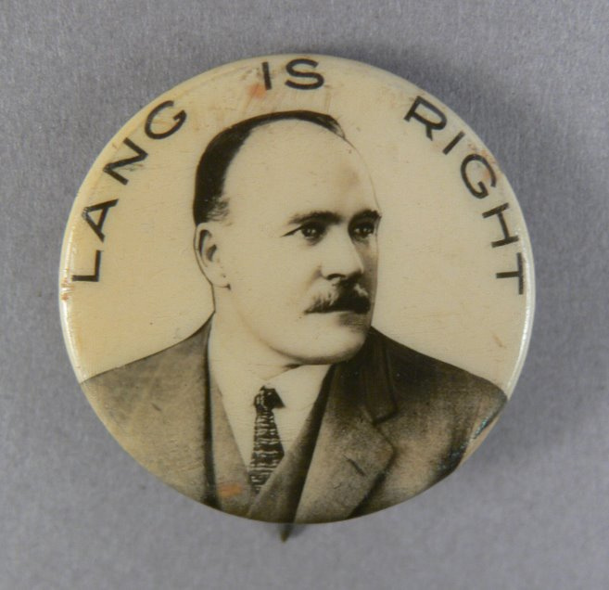
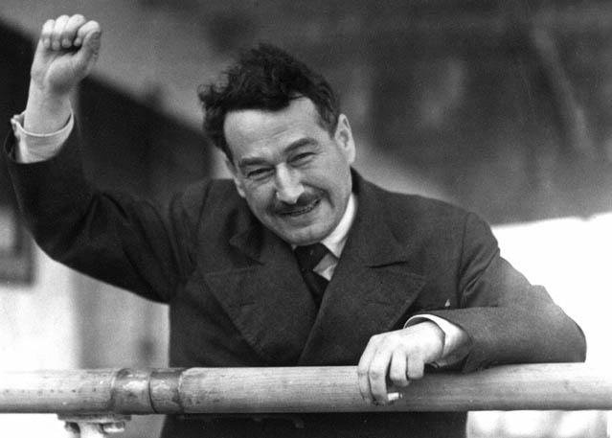
Great Depression
1930s see expansionist dreams turn into nightmare, Australia could barely pay its debts let alone borrow more
Acute unemployment led to widespread anti-immigration feeling
Dictation Test used for censorship in the barring of Egon Kisch
Lyons accept 15,000 refugees in wake of Czechoslovakia - 'ill wind of Nazi tyranny blow this country good' Sydney Morning Herald
'absorbed into the Australian community without affecting living standards & without detrimental effect to Australian workers' Minister for the Interior John McEwen's Cabinet submission
Notes:
5

Slide 6
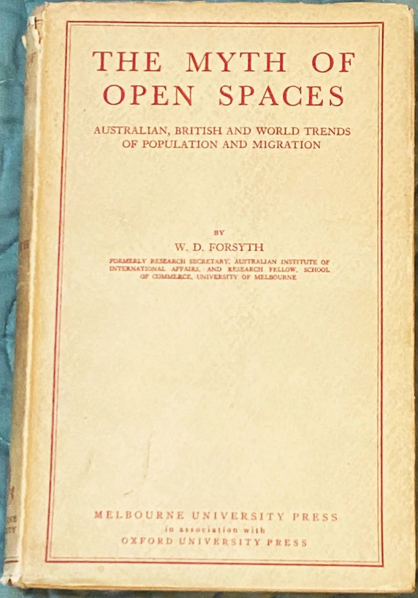
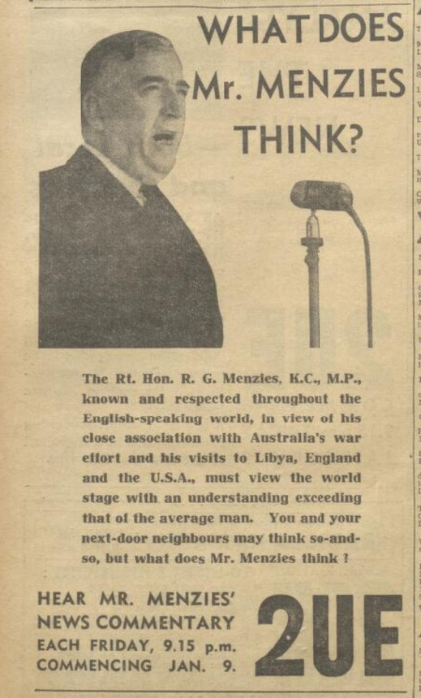
The War prompts a 'Top Down' Revolution
‘The greatest guarantee, not only of the safety of Australia but of its future material prosperity, would be a population of at least twenty million. If we are to rely on natural increase, this goal cannot be achieved for a century or two – and with our present population we may not hope to last so long as an independent people. The inevitable deduction from this is that we must have a positive, active and vigorous encouragement of migration. Yet, if you turn your minds back you will recall that for fifteen years before this war there was an attitude of mild hostility on migration into Australia. Are we proposing to resume this outlook when the war is over? Are we going to be timid about the temporary effect, social and industrial, of large migration, or are we to see in it a real source of strength? It is curious that a race so mixed as our own, which derives its strength and resilience from its mixture of English, Irish, Scots, Welsh, Cornish and, going back further, the Celt, the Angle, the Saxon, the Norman, should have become recently so sensitive about the purity of its blood. Migration into Australia, particularly from Northern European counties, will in the long run bring to us nothing but vigour and advantage.’ Robert Menzies 1943

Slide 7
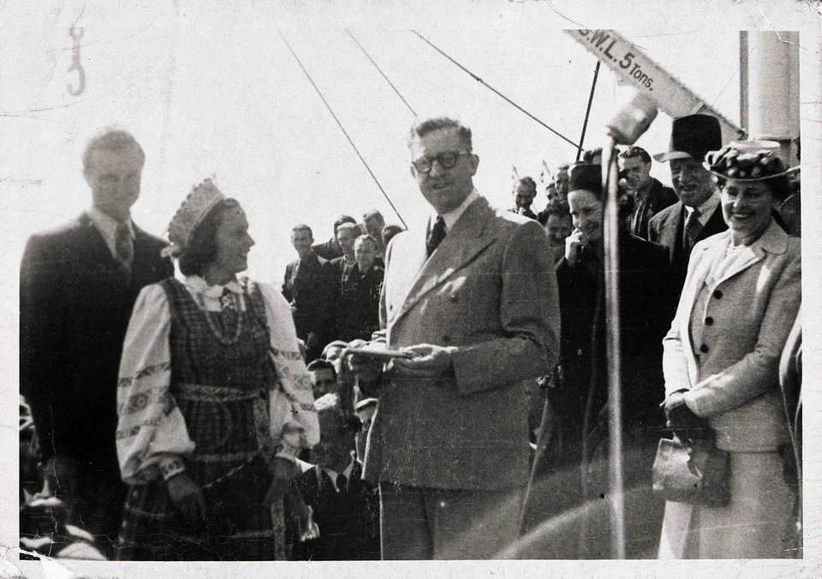
The 'Beautiful Balts' & Calwell's strict application
‘We would bring one shipload with nobody under fifteen and nobody over thirty-five, all of whom had to be single … Many were red-headed and blue-eyed. There was also a number of natural platinum blondes of both sexes. The men were handsome and the women beautiful. It was not hard to sell immigration to the Australian people once the press published photographs of that group.’ Arthur Calwell
Deportation of non-white refugees, barring of servicemen's brides
Iconic cases of Lorenzo Gamboa & Frank Yang; later overturned

Slide 8
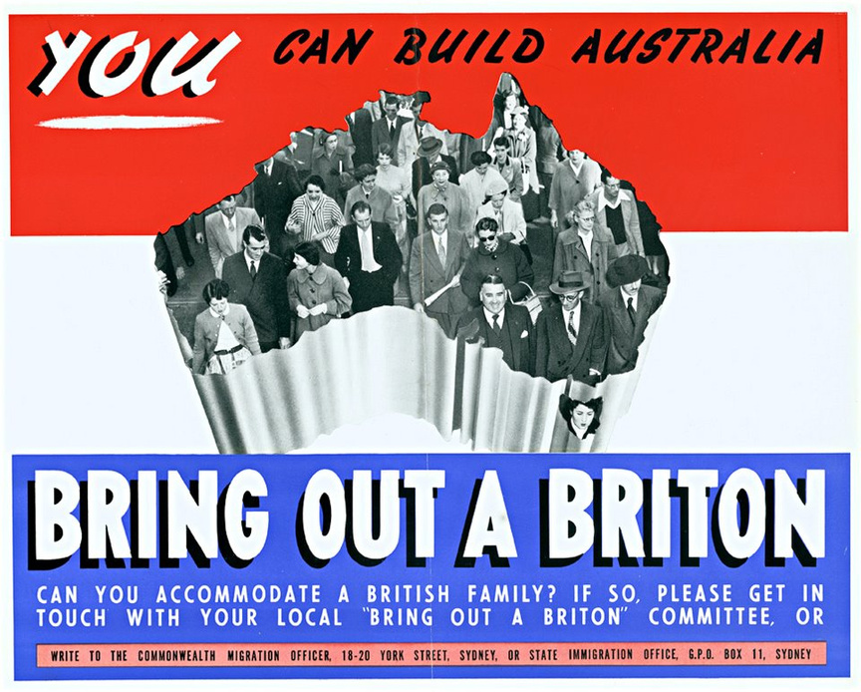
Still British?
'For every foreign migrant there will be ten from the United Kingdom' Calwell
Nationality and Citizenship Bill 1948 – explicitly not end British migrant privilege, just follow a Canadian precedent which had undermined the universality of being a 'British subject'
'10 Pound Poms'
'Bring out a Briton'
'Empire Youth Booklet' teach newly arrived children to adore the Royal Family

Slide 9
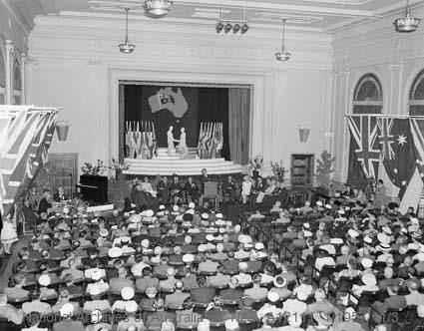
Australian Citizenship Conventions
Assimilation aimed at reassuring Australian public
Paired with Good Neighbour Movement
‘Still too much anti-immigration and anti-alien sentiment to abandon the best weapon we have yet found to combat it’ Harold Holt
Economic prosperity crucial to success
Shift from Assimilation to Integration as climate of fear & resentment dissipated

Slide 10
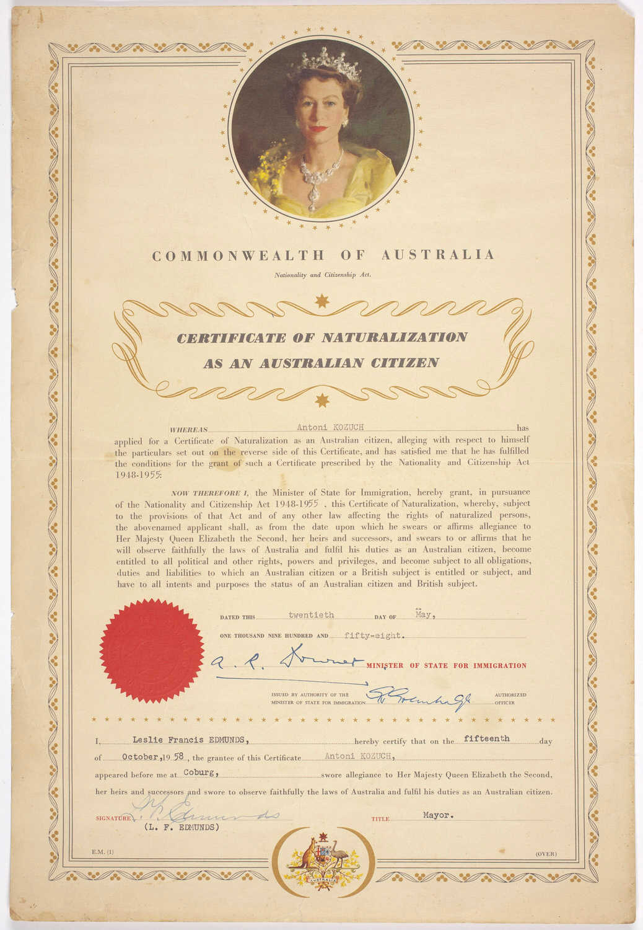
Step by Step liberalisation through 1950s
'the flow of good people, with a variety of cultures & experiences & backgrounds into this country is giving to us a strength, a vigour, a variety of minds which we would never otherwise have acquired' Menzies 1961
Deportations wound up
Partners of Armed Forces allowed in
'Naturalisation' made easier
From 1957 non-Europeans could become citizens but face longer eligibility requirement
1958 Nationality and Citizenship Act abolish the 'archaic' Dictation Test

Slide 11
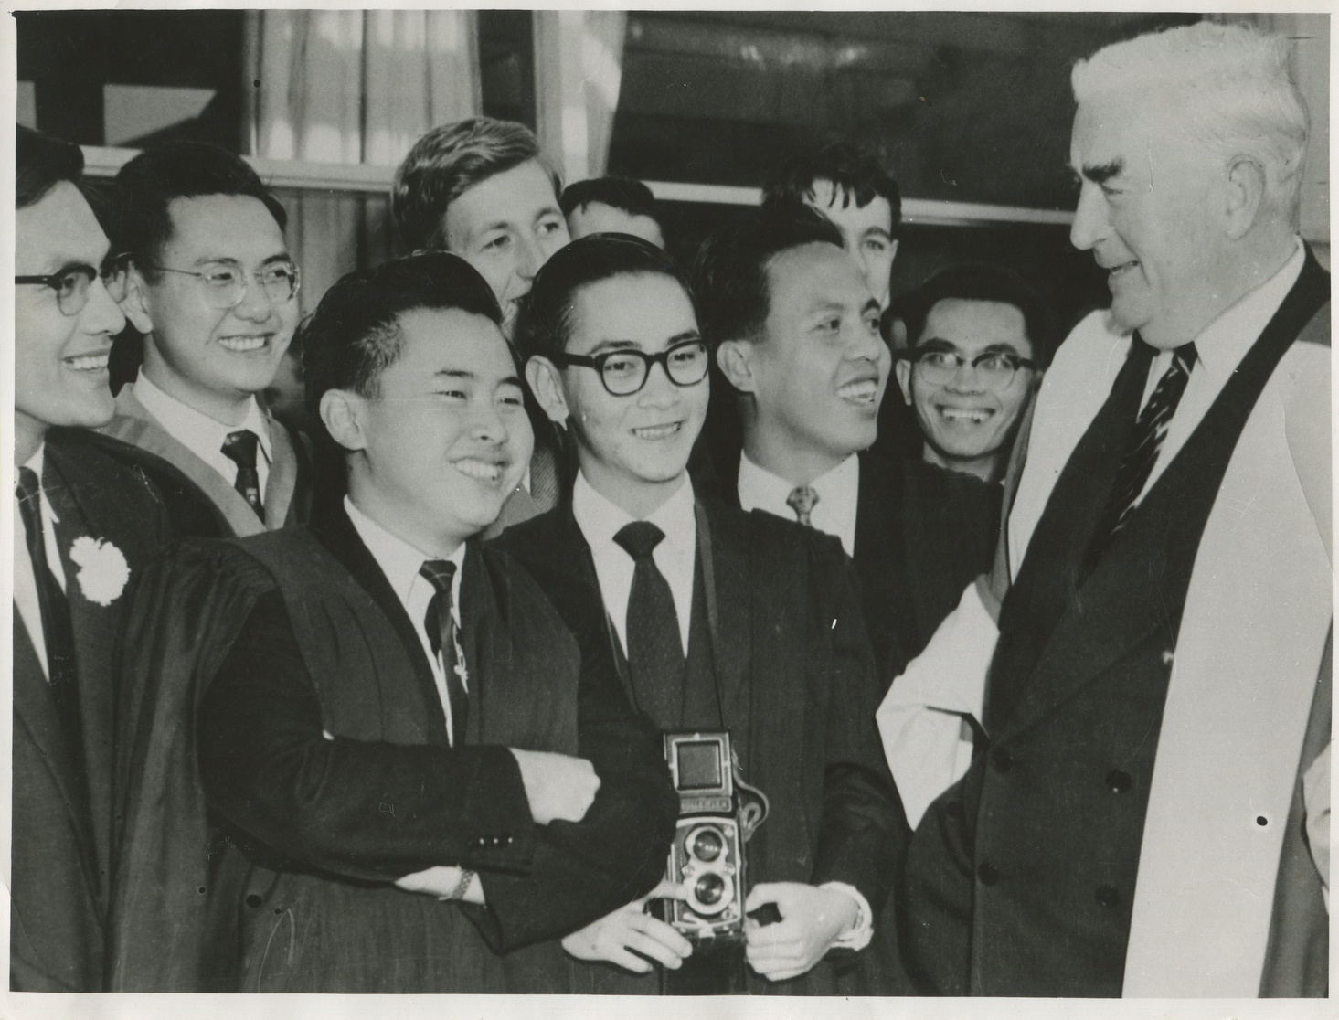
The Colombo Plan
Brainchild of External Affairs Minister Percy Spender
Anti-Communism as the new populate or perish
Deliberate attempt to engage with Asia, spread prosperity & improve Australia's flawed reputation
Almost 6000 Colombo students during the Menzies era & far more private international students
‘break down prejudices and misunderstandings on both sides’ Richard Casey

Slide 12
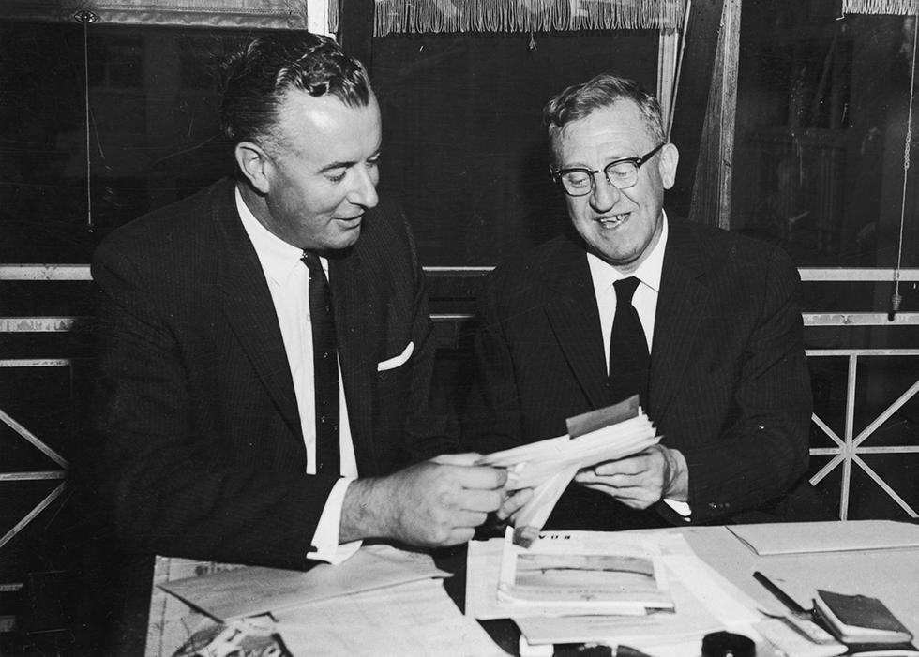
Abolition & Conclusion
Generational change as Menzies & Calwell succeeded by Holt & Whitlam
Australian public carried over on a long journey
1966 Migration Review abolish the core of the White Australia policy, as migrants accepted on basis of 'suitability to settle, ability to integrate & professional qualifications' regardless of race or nationality
1973 see Whitlam remove last remnants & replace with an official policy of multiculturalism
Endurance of imperatives to hoard & to grow

