Slide 1



More Than Dominoes: Cold-War Strategic Defence Before Vietnam
Dr Zachary Gorman, Academic Coordinator at the Robert Menzies Institute
Notes:
1

Slide 2
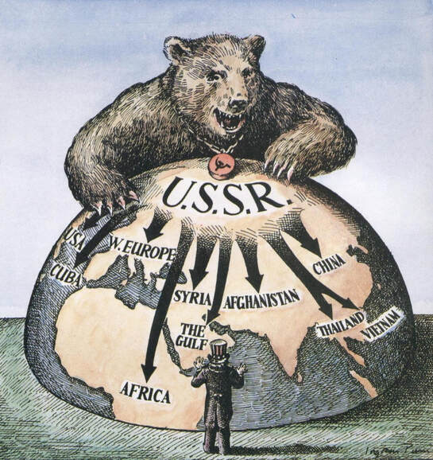
The Reality of the Dominoes
  Blitzkrieg & Japanese advance serve as examples of rapidly falling dominoes
  Descent of 'Iron Curtain' show communist intent
  Victory of Chinese Communist Party establish China in a position to act as a Stalin in an area which was just as politically destabilised as Eastern Europe
  While Truman had backed containment in Greece & Turkey, 'Domino Theory' phraseology not popularised until 1954

Slide 3
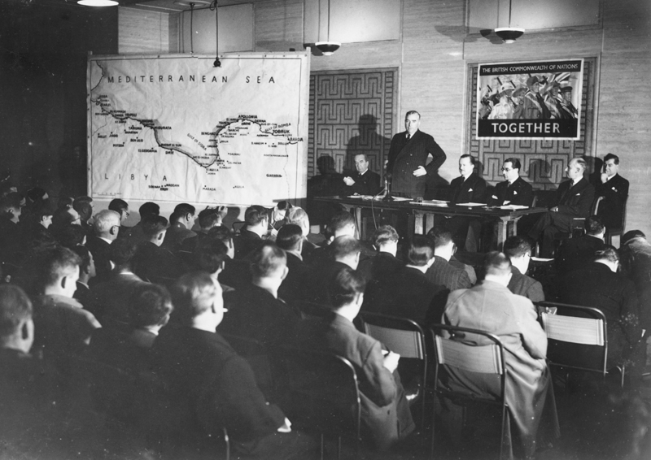
Forward Defence as Australia's Strategy
Key Points to forward defence:
  Must be in the region
  Must involve a 'great and powerful friend'
  Limited resources = insurance policy
  Preferably act as part of an international coalition
  Must be asked, no 'regime change'

Slide 4
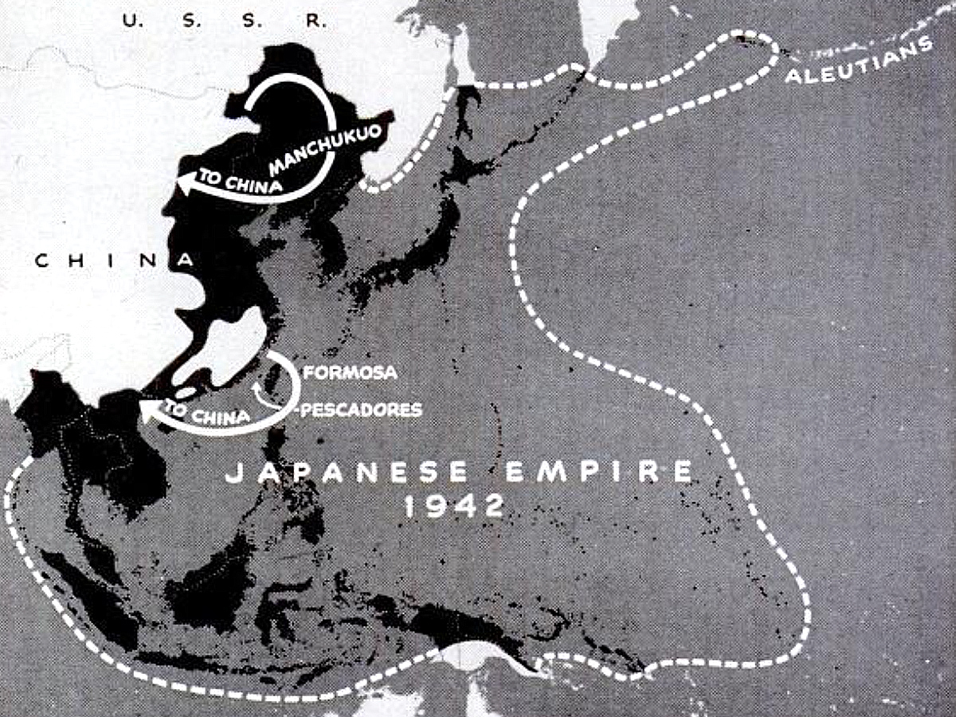
The Fractured Landscape of Post-War Asia
  Shaped by the legacies of colonialism and Japanese conquest, nations were often arbitrary constructs
  Ousted colonial regimes try to reassert themselves, or offer path to independence
  Nationalism & communism, ironically European in origin, seized political imaginations
  Identifying who was legitimate a fraught task

Slide 5
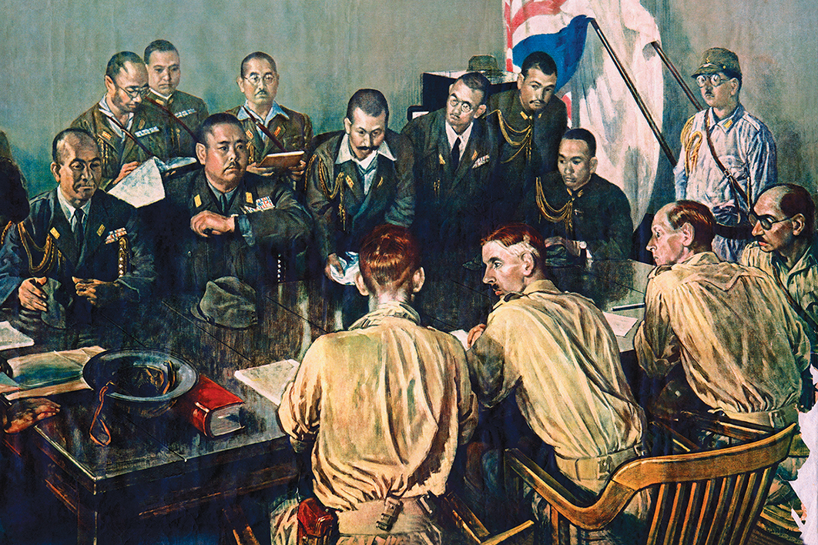
Australia's Position
  WW2 confirm Australia's isolation complex
  'Look to America' fleeting
  Aware of its own weakness, Australia had tried to steer clear of post-colonial conflicts in Dutch East Indies & even Hong Kong
  Chifley's cautious approach carried over by Menzies
  Colombo Plan of extensive foreign aid show commitment to 'hearts & minds' not just weapons

Slide 6
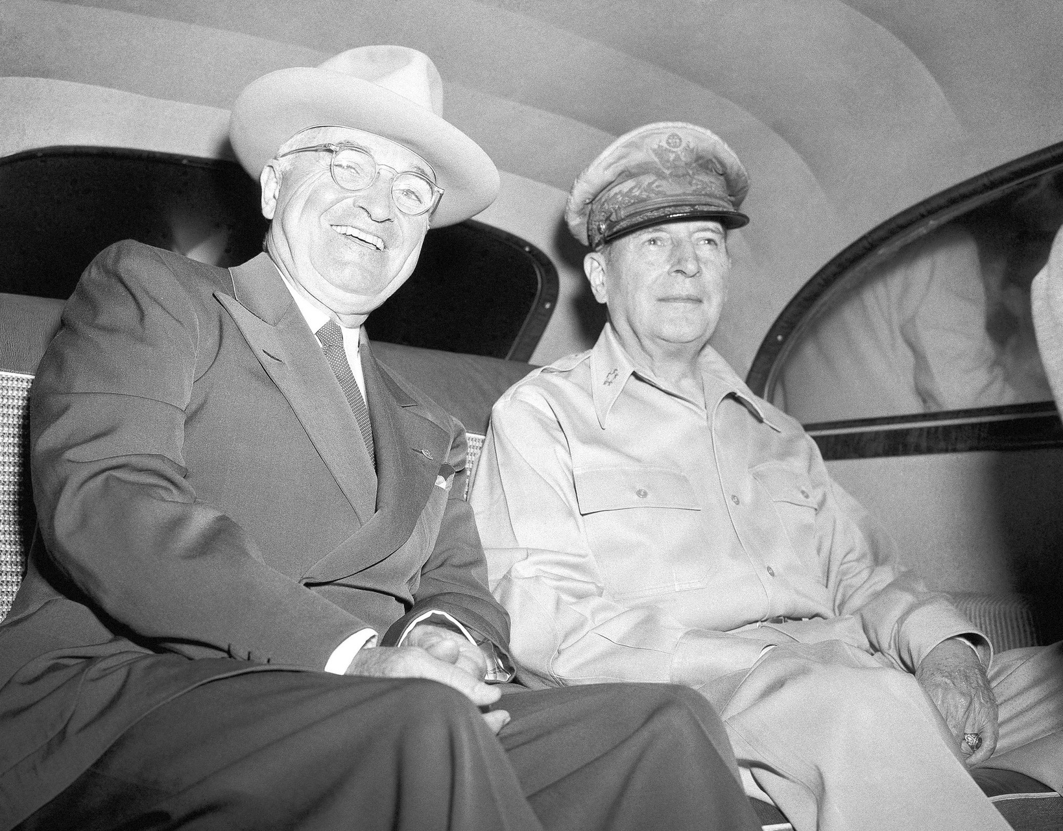
Korean War
  Seem to confirm communist expansionism, backed by the Chinese Communist Party
  Menzies reluctant to commit to distant war
  Ideal situation of having both g&p friends plus UN backing
  MacArthur as the embodiment of American recklessness
  Economic crisis lead to £200mill military spending cap

Slide 7
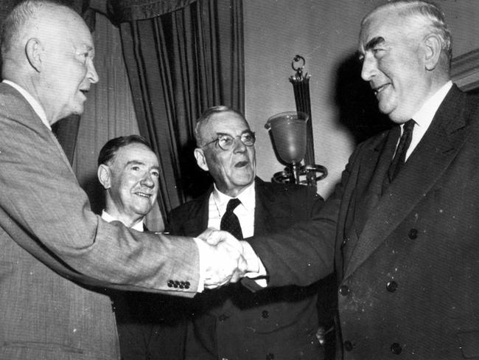
ANZUS and its Limitations
  Price of 'soft' peace, allow for Middle East role
  'A superstructure built on a foundation of jelly'
  US reliance on nuclear deterrent for Asia
  Addition rather than replacement for Britain

Slide 8
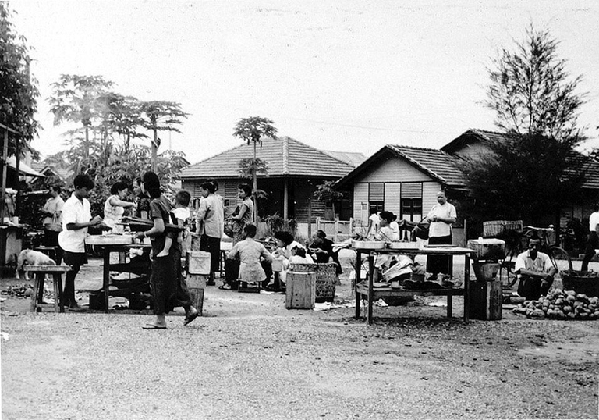
Malayan Emergency
  On 16 June 1948 three British estate managers in northern Malaya were assassinated by MCP guerrillas
  Concern that a ‘militaristic policy’ would be unpopular both domestically and in the region lead to Australian caution
  Britain & US split over Malaya & Indochina reveal limits of dominoes
  Malaya as model of counterinsurgency

Slide 9
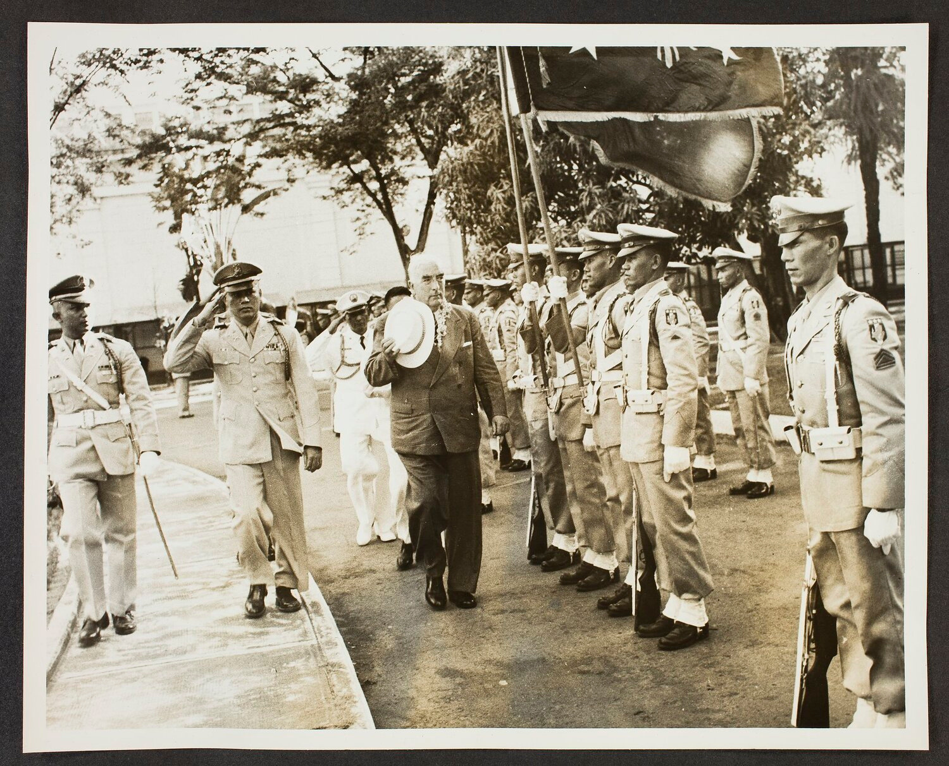
SEATO
  Signing of treaty in 1954 by US, UK, NZ, France, Thailand, Philippines, Pakistan
  US remain committed to nuclear deterrent, but Australia adopt a ‘fire brigade’ approach
  Suez Crisis raise prospect of complete UK withdrawal

Slide 10
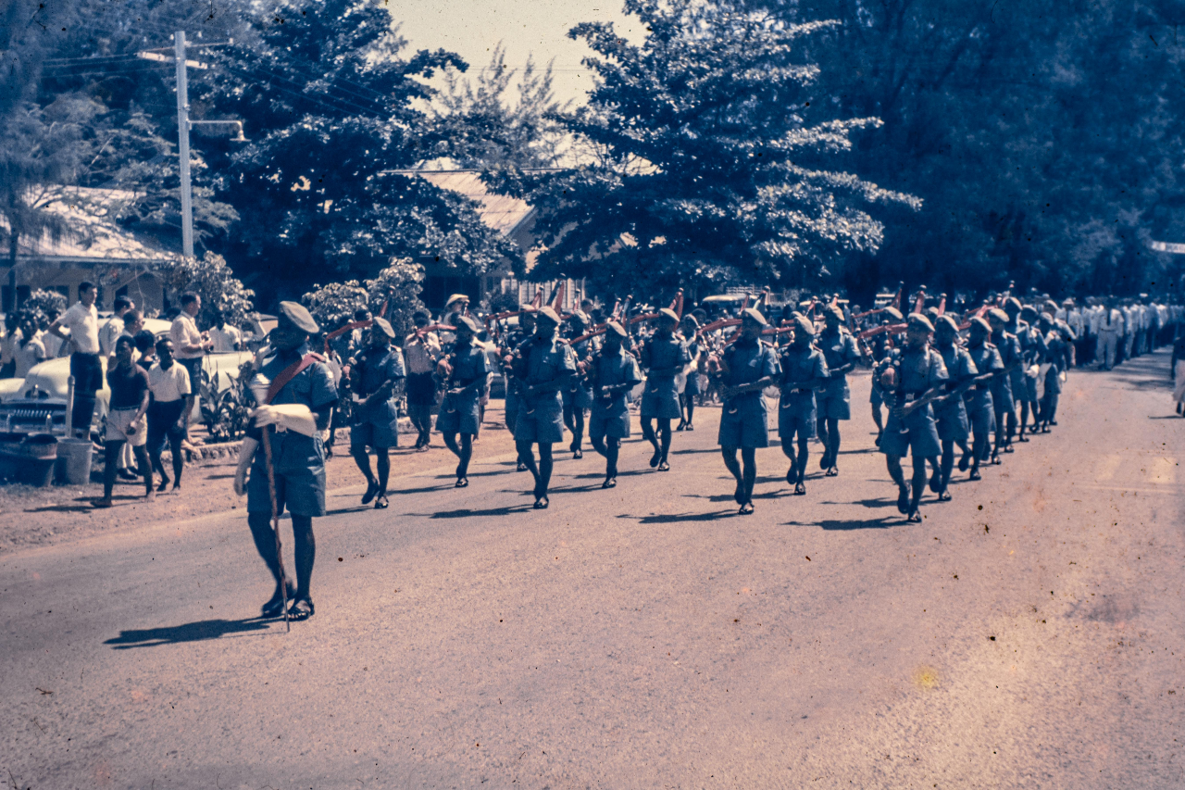
West New Guinea Dispute
  Considered a vital buffer zone
  Indonesia receive Soviet submarines and planes
  Minister for External Affairs Richard Casey accused of 'appeasement'
  1959 The Defence Committee recommend that Australia ‘should be prepared to act independently at least for a time’ in limited war against Indonesia, and that ‘our forces … should be designed primarily with the ability to act independently of allies’

Slide 11
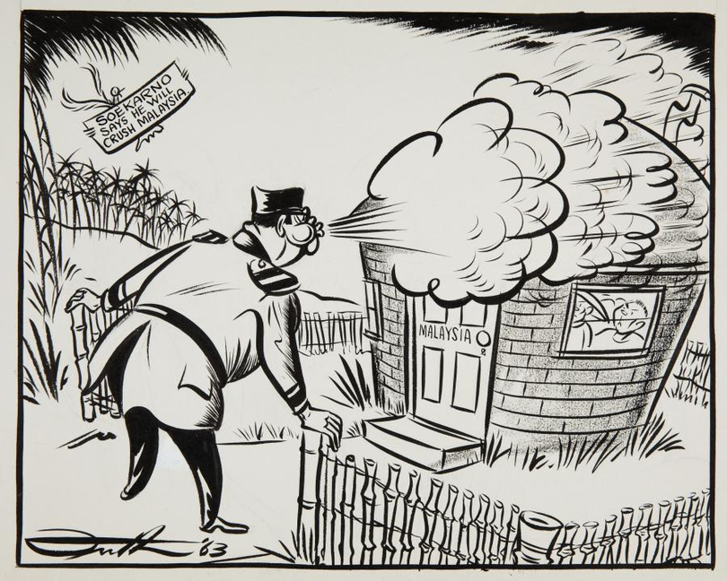
Konfrontasi
  1961 proposal to create the Federation of Malaysia, which would combine the current states of Malaya, Singapore and the British territories of North Borneo (to be renamed Sabah), Sarawak and the Sultanate of Brunei
  Indonesia hope to replicate WNGD
  Kennedy's extremely limited assurance that ANZUS would apply

Slide 12
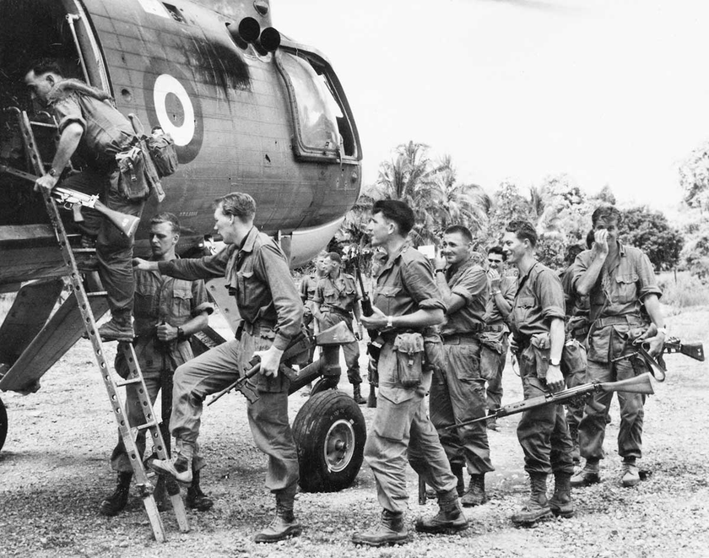
Graduated Response
  Nuanced approach orchestrated by Minister for External Affairs Garfield Barwick
  Initially refuse the request for military assistance, then offer to relieve troops serving elsewhere in Malaysia, & finally make a commitment of a battalion & SAS troops to be ‘eyes and ears’
  Olive branches: cooperating on the demarcation of the border between Papua New Guinea and West New Guinea, Indonesian students welcome under Australian training programs, development aid continued under the Colombo Plan, small number of Indonesian army officers remained enrolled at the Australian Army’s Staff College

Slide 13
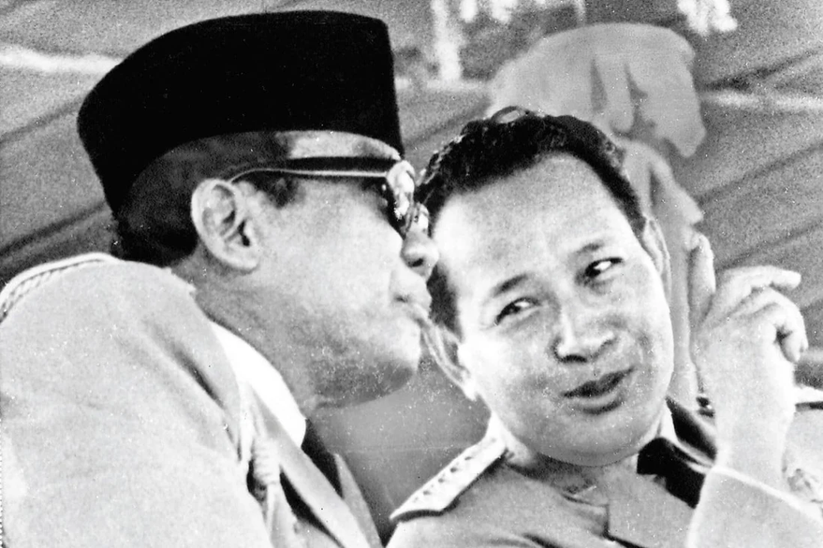
The Sudden Death of Indonesian Communism
  Late 1964 Sukarno speaks of a Beijing– Jakarta– Hanoi– Phnom Penh– Pyongyang axis, move a full brigade of Indonesian troops to Borneo border
  Australia commit to increasing its standing army by 5000 men & embark on a major upgrade of its air force
  Night of 30 September–1 October 1965 botched coup
  In March 1966 Suharto took many of the presidential powers from Sukarno, but let him retain the title; in March 1967 Suharto became Acting President; and only in March 1968 did he formally become President, the office he would hold for the next 30 years
  Confrontation only officially ended August 1966

