Slide 1


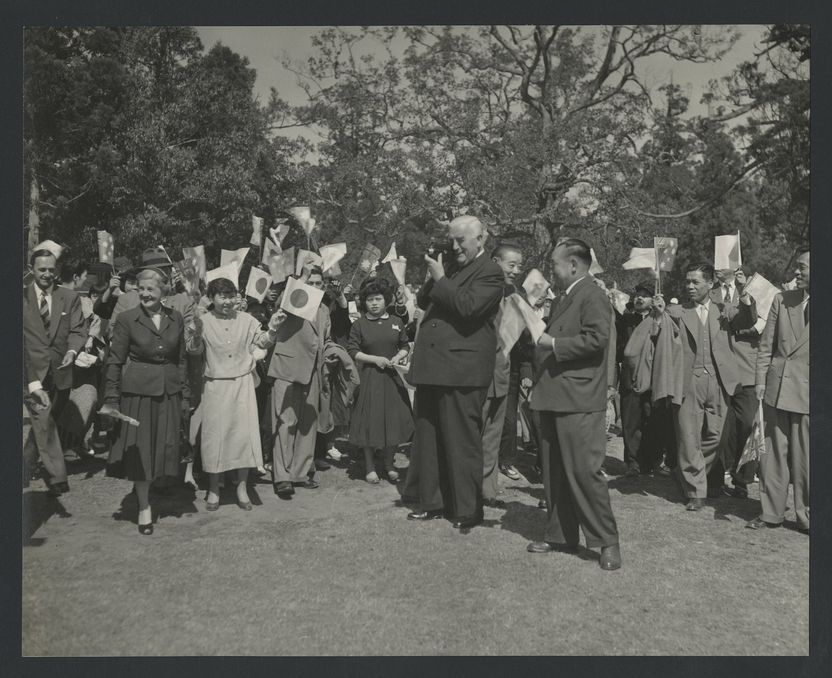

From Far East to Near North: Australia’s Engagement with Asia 1941-1972
Dr Zachary Gorman, Historian of the Robert Menzies Institute at the University of Melbourne
Menzies in Japan, April 1957
Source: Baillieu Library, University of Melbourne
Notes:
1

Slide 2
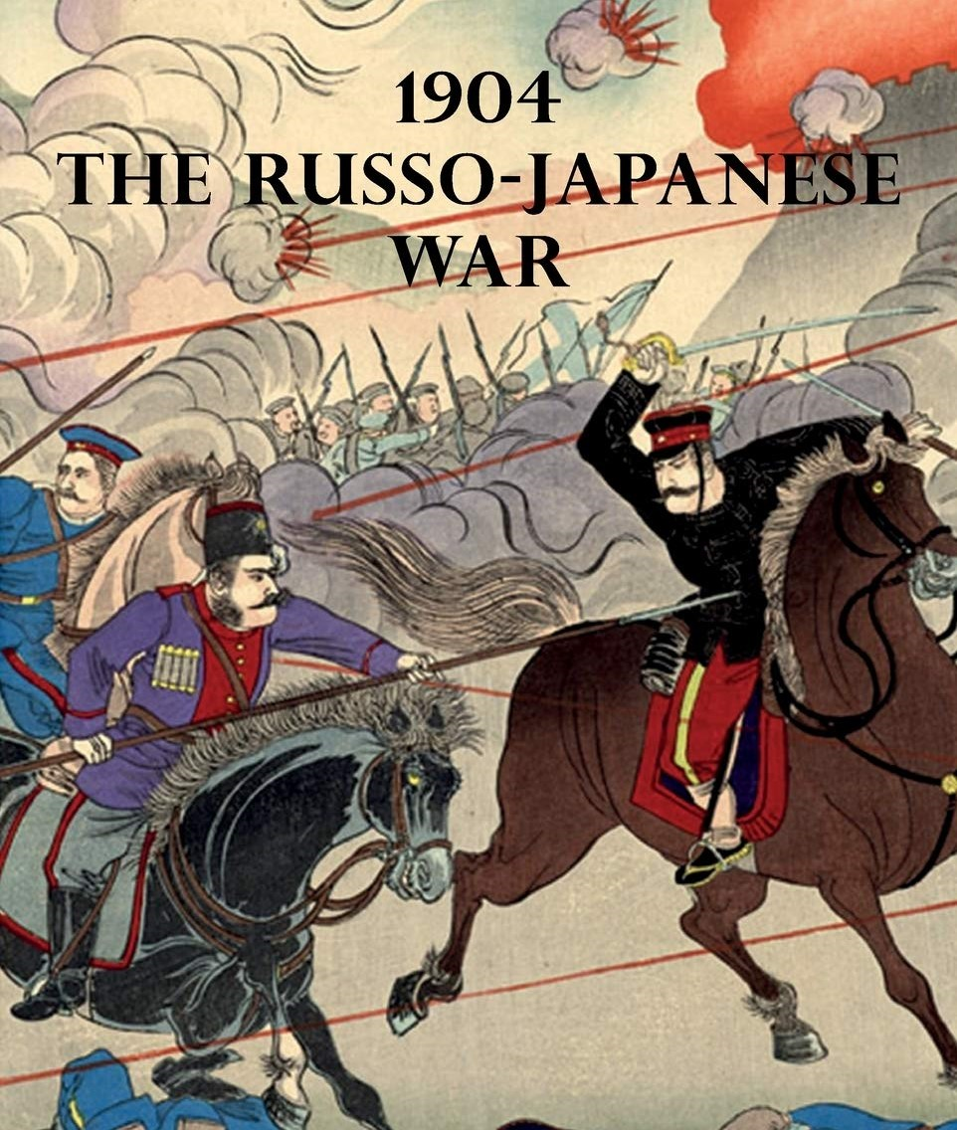
When did Engagement Begin?
  Problems with periodisation
  Indigenous Australians develop trade networks with Indonesia
  State & Federal ‘Commercial Agents’ predate diplomatic network
  NSW Premier Joseph Carruthers violate British neutrality to sell 12,000 horse during Russo-Japanese War (1904-5)
  Japanese Consulate est in Townsville 1896, Chinese Consulate est in Melbourne 1909. But not reciprocated as Britain handle Australia’s international relations
Source: Sharf Collection, Museum of Fine Arts, Boston

Slide 3
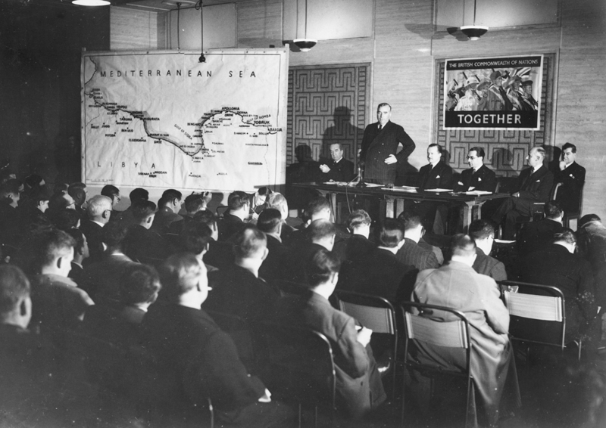
War as spur to Engagement
  League of Nations mark beginning of Australia’s ‘independent’ diplomacy
  Billy Hughes oppose racial equality clause
  ‘What Great Britain calls the Far East is to us the Near North. Little given as I am to encouraging exaggerated ideas of Dominion independence and separatism… I have become convinced that in the Pacific Australia must regard herself as a principal, providing herself with her own information and maintaining her own diplomatic contacts with foreign powers… I look forward to the day when we will have a concert of Pacific powers, pacific in both senses of the word’
Source: Australian War Memorial

Slide 4
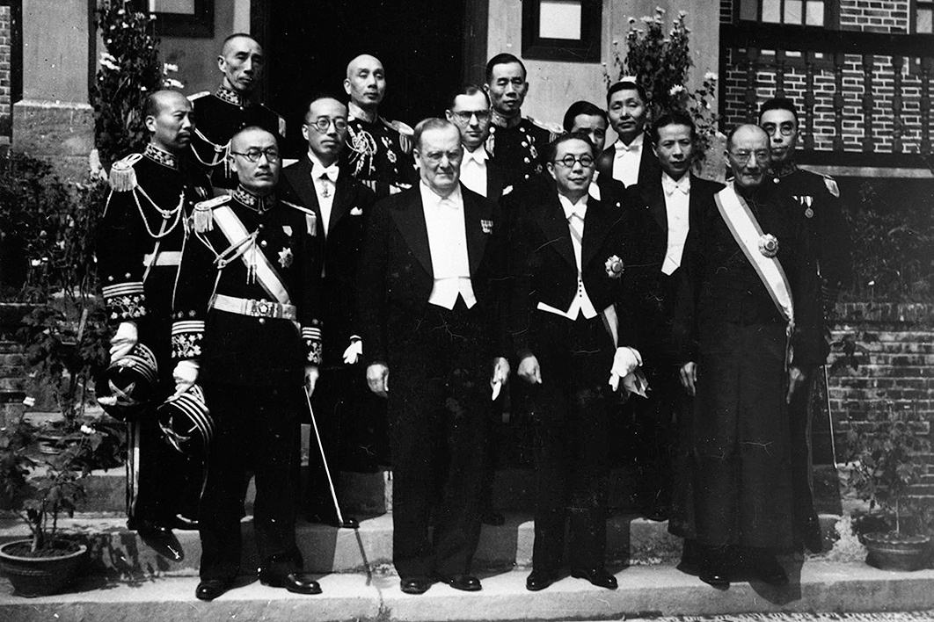
Dispatch of the ‘Ministers’
  ‘Ministers’ (Ambassadors) sent to Japan, China & USA 1940-41
  Frederic Eggleston graduate from China to USA suggest relative equality of the diplomatic postings
  Delegation in China’s wartime capital of Chungking feature first Chinese-Australian diplomat in translator Charles Lee
  Dead ends: engagement with Japan severed by the outbreak of war in the Pacific, engagement with China severed by Communist victory in the Chinese Civil War
Source: Sir Keith and Lady Waller Collection, National Library of Australia
Notes:
4

Slide 5
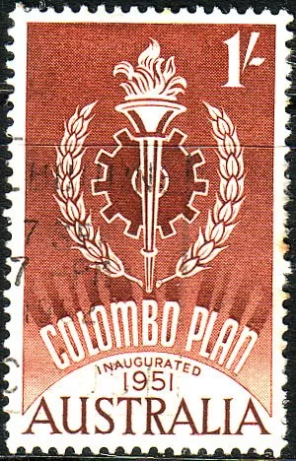
‘Developmental’ Diplomacy
  Seek Asian allies in fight against global communism, but Commonwealth connections equally important
  Australia disappointed at India’s non-alignment, but relieved by Indonesia’s
  Australian aid spending peak at 0.48% of GDP in 1967-8, currently sitting at 0.18% of GDP
  Economic development as the antidote to communism
  ‘Colombo Plan’ conceived by Percy Spender & others at 1950 meeting in Ceylon/Sri Lanka. Initially just for the Commonwealth nations but quickly expanded
Source: Commonwealth Stamp Store

Slide 6
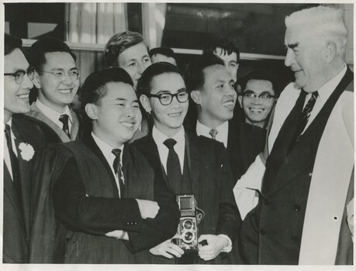
International Students vs White Australia Policy
  Colombo Plan & fee paying students allowed to bypass the policy
  Foster gratitude & goodwill amongst a generation of future Asian leaders
  Policy not dismantled until 1966 onwards, but significantly liberalised during 1950s. Dictation test abolished 1958
  International criticism pick up in 1960s rather than 50s
  Some Asian countries maintain their own systems of discrimination, hence less likely to object to Australia’s
Source: Baillieu Library, University of Melbourne

Slide 7
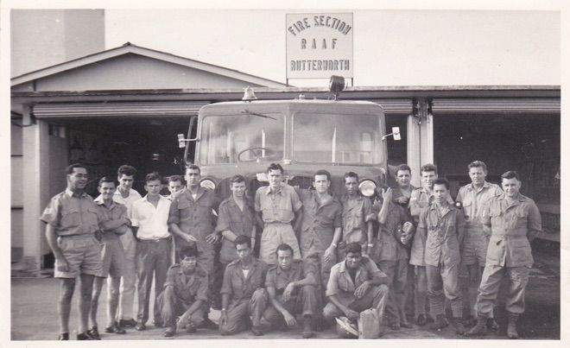
Malaya/Malaysia
  Aus fight two conflicts to defend: Malayan Emergency (1948-60) & Konfrontasi (1963-66)
  Positive relationship with Britain lay platform for Australia’s engagement
  Major aid recipient & student source. 300,000 graduates of Australian Universities living in Malaysia
  Former Aus Governor General William McKell help draft Malayan Constitution
  Defence cooperation program, including enduring Aus military base at Penang: RMAF Butterworth
Source: RAAF Fire Service
Notes:
7

Slide 8
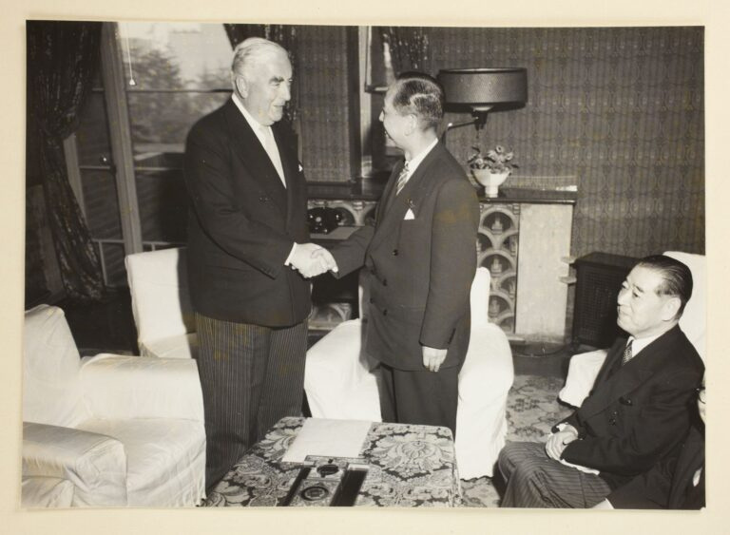
Japan
  Aus occupation forces stationed until 1952
  ‘Soft’ Peace Treaty of San Franciso signed 1951, aim at economic rebuild & western embrace
  Petition of 100,000 signatures protest ratification
  Australia sponsor Japan’s readmission into community of nations
  1957 commerce agreement re-orientate Australia’s trade towards Asia. By early 1970s Japan had replaced Britain as Australia’s no. 1 trading partner
Source: Baillieu Library, University of Melbourne
Notes:
8

Slide 9
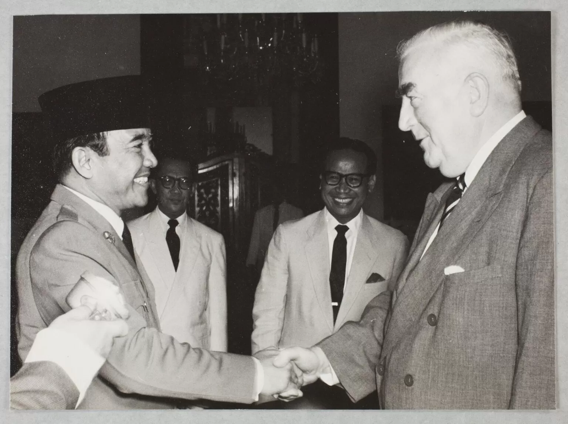
Indonesia
  Dutch East Indies a wartime ally
  United Nations Committee for Good Offices on Indonesia see Aus act as ‘midwife’ to the birth of an independent Indonesia
  Expansionism in West New Guinea, Borneo & East Timor cause tensions
  Nuanced approached epitomised by Aus training Indonesian military officers simultaneous with fighting a clandestine war against them during Konfrontasi
  Accusations of ‘appeasement’ but no.1 priority of ‘relative’ peace achieved
Source: Baillieu Library, University of Melbourne
Notes:
9

Slide 10
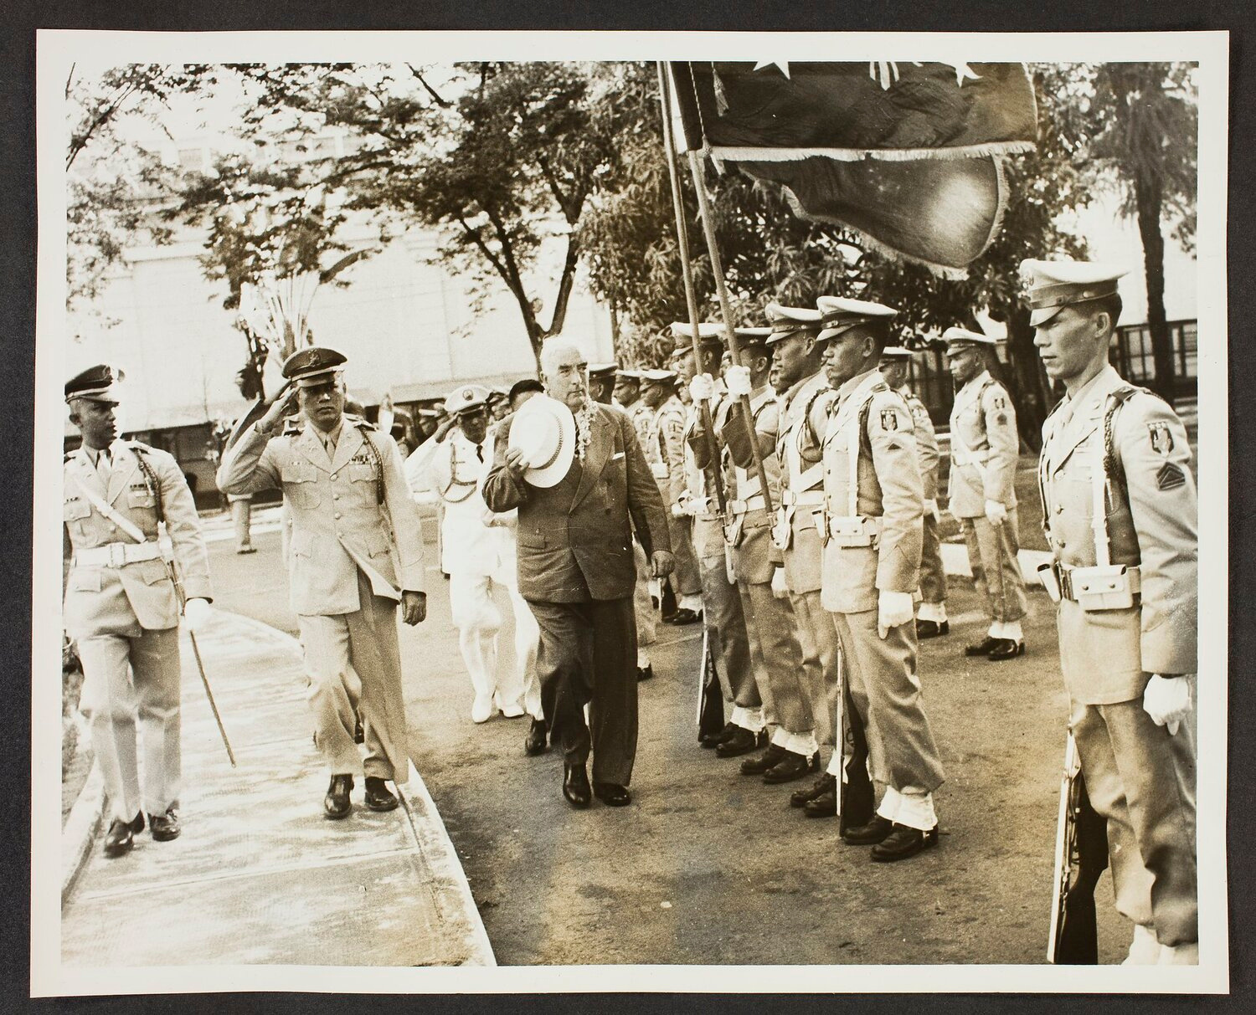
South Vietnam/SEATO
  Enthusiastic embrace of President Ngo Dinh Diem during 1957 visit contrast with tensions surrounding Kishi
  Signed 1954 by US, UK, NZ, France, Thailand, Philippines, Pakistan. South Vietnam, Cambodia & Laos non-signatories but covered by treaty’s provisions
  Asian allies visited in line with SEATO meetings
  Fall far short of NATO model, dissolved 1977
  Large foreign aid investment, but not celebrated in the manner of Colombo
  Fraser Gov’s subsequent embrace of South Vietnamese refugees a key moment in birth of multi-cultural Australia
Menzies’s visit to SEATO Ally the Philippines in 1957
Source: Baillieu Library, University of Melbourne
Notes:
10

Slide 11
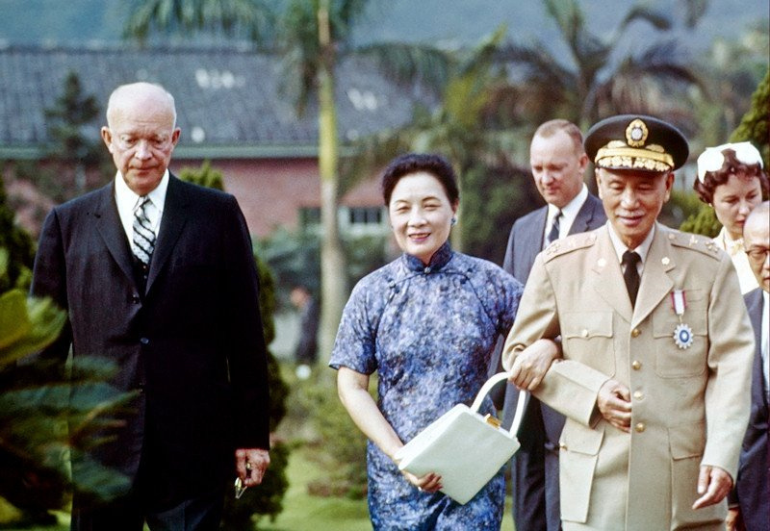
China & Taiwan (Formosa)
  Positive for West that Taiwan take China’s UN Security Council seat
  Aus urge restraint during Taiwan Strait crises of 1954 & 1958, not as pro-Taiwan as USA
  British desire to keep Hong Kong see it recognise People’s Republic & stay out of Vietnam
  Pro-Taiwan rhetoric increase 1966-72
  Harry Menzies’s 1956 Trade Tour lead to huge wheat sales by the early 1960s
  Aus initially side with Soviets in Sino-Soviet Split
Source: Unknown USAID Photographer
Notes:
11

Slide 12
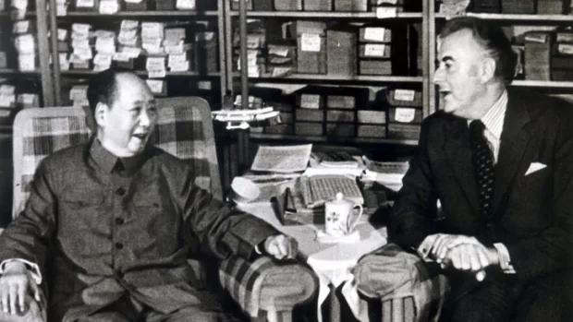
Conclusion
  Whitlam’s groundbreaking July 1971 visit to PRC make Taiwan an election issue, but partly facilitated by American rapprochement with China, so not as radical as McMahon made out
  Harold Wilson’s 1968 announcement of British withdrawal ‘East of Suez’
  1973 Britain finally join European Economic Community (later EU) after previous attempts blocked by France
  Britain arguably left Australia, rather than Australia leaving Britain, but writing was on the wall for long enough that we were well prepared
Source: National Archives of Australia

