Slide 1


2025 SPEECH
COMPETITION
CLASSROOM ACTIVITY
Robert Menzies Institute
schools@robertmenziesinstitute.org.au
www.robertmenziesinstitute.org.au/research-learning/learning/speech-competition/

Slide 2
Purpose of Task
Speeches are an opportunity to develop confidence in researching, public speaking and writing abilities.
This speech task will be of additional value as it concerns Sir Robert Menzies, his beliefs and actions. Menzies is Australia’s longest serving Prime Minister and is thus a significant historical and political figure.
Preparing and researching for this task will enable a deepened understanding of the history of Australian politics and democracy.
Robert Menzies Institute
schools@robertmenziesinstitute.org.au
www.robertmenziesinstitute.org.au/research-learning/learning/speech-competition/

Slide 3
2025 Topic
The speech competition relates to the following quote by Robert Menzies:
“if truth is to emerge and in the long run be triumphant, the process of free debate, the untrammelled clash of opinion must go on”
Hence, students must create a speech addressing the following:
How important is respectful debate to the health of a democracy?
You must refer to Robert Menzies’s involvement in advancing debate through his actions and policy.
Robert Menzies Institute
schools@robertmenziesinstitute.org.au
www.robertmenziesinstitute.org.au/research-learning/learning/speech-competition/

Slide 4

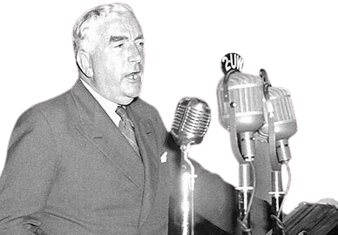
Timings + Prizes
Year 7/8: 3-5 minutes [$500 + $200 worth of books]
Year 9/10: 4-6 minutes [$1000 + $200 worth of books]
Year 11/12: 5-7 minutes [$1500 + $200 worth of books + invitation to deliver their speech at the Robert Menzies Institute Annual Conference in November 2025]
Robert Menzies Institute
schools@robertmenziesinstitute.org.au
www.robertmenziesinstitute.org.au/research-learning/learning/speech-competition/

Slide 5
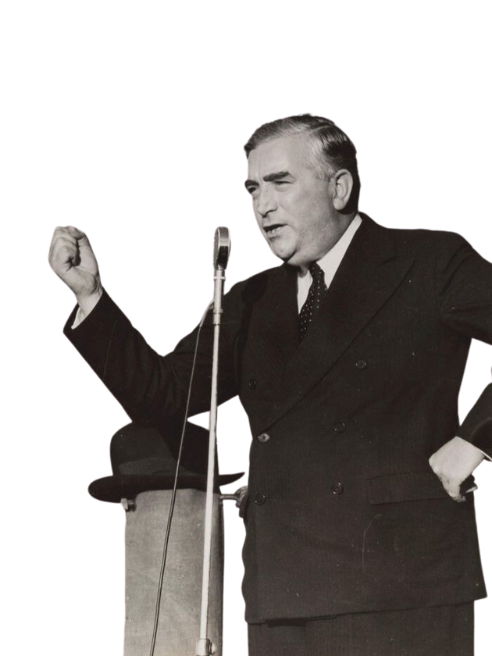
Judging & Grading
Speeches will be assessed on:
  Preparation
  Subject matter
  Structure
  Delivery
  Students must provide a hardcopy of the speech and supporting notes to show their research and include a list of references.
  The speech must engage directly with the theme and demonstrate strong argumentation with a clear introduction, body, and conclusion.
  Students will be judged on their use of confident and appropriate language that is clear and audible to the listener.
Robert Menzies Institute
schools@robertmenziesinstitute.org.au
www.robertmenziesinstitute.org.au/research-learning/learning/speech-competition/

Slide 6
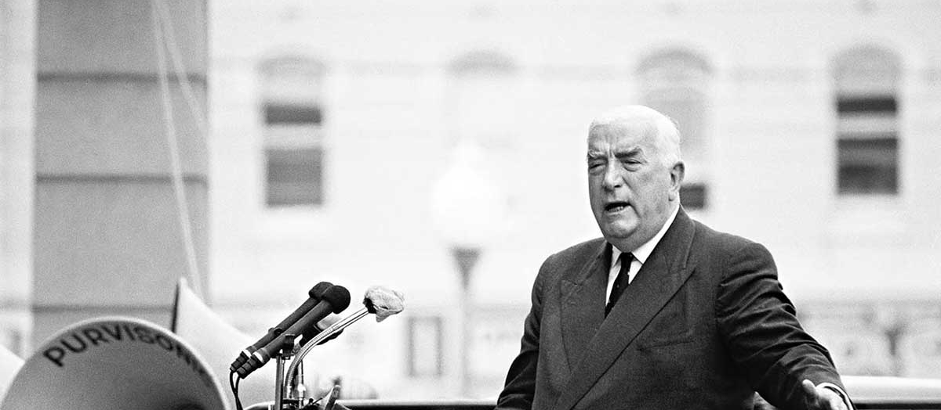
RESOURCES + SUBMISSION
Resources to assist with developing and submitting an exceptional speech can be found on:
https://www.robertmenziesinstitute.org.au/research-learning/learning/speech-competition/
Robert Menzies Institute
schools@robertmenziesinstitute.org.au
www.robertmenziesinstitute.org.au/research-learning/learning/speech-competition/

Slide 7
GOOD LUCK!
Thank you for engaging with this exciting task & good luck with your speech!
Entries are due on the 20th of July, 2025.
Robert Menzies Institute
schools@robertmenziesinstitute.org.au
www.robertmenziesinstitute.org.au/research-learning/learning/speech-competition/

